Slide 1
Using the eTool to Shape Your Transaction
Getting Basic Information from the Report and How to Use It
June 17, 2020
Presenter: Robert Robinson

Slide 2
Terminology
Physical Condition Assessment (PCA)
eTool
eCNA
Assessor
ADRR
IDRR
Scope of Work

Slide 3
Topics
Not Covered
How to procure an assessor
How to complete and submit the eCNA
Covered
How to interact with the assessor
How to read/use the data to shape your transaction

Slide 4
Context: Current Public Housing Practices
Maintain the Property
Limited funding means limited priorities;
Critical items are often fixed rather than replaced.
Minimize Capital Expenditures
Capital Funds are precious;
Only spent when absolutely necessary.
Defer Replacement of Components
Useful lives are stretched in order to save money;
Revitalization efforts are limited by low or nonexistent reserve funds.

Slide 5
Why is a PCA Important?
Identifies the physical needs of the property:
Immediate (Critical);
Necessary Rehab;
Ongoing over the next 20-years.
Generally speaking:
The Immediate must be completed prior to conversion;
Necessary Rehab items make up the RAD Scope of Work; and
The on-going needs determine the Annual Deposits to Replacement Reserves (ADRR), subject to any Initial Deposit to Replacement Reserve (IDRR).
NOTE: The PCA also shapes the proposed financing strategy. If the capital needs identified are larger than available resources (say, available Operating Reserves or Capital Funds), the PHA will then need to pursue outside funding, e.g., mortgage proceeds, tax credit equity, or other grant or soft funds.

Slide 6
Common Deviations
Sometimes you may want/choose to accelerate certain work identified in the 20-year schedule, which will increase your Scope of Work and decrease your ADRR.
Or, you may want to reduce your ADRR by increasing your IDRR.

Slide 7
Navigating the Tool
Finding the Immediate, Rehab, and 20-Year Data

Slide 8
What is a PCA for RAD
Two components:
Narrative report:
Part 1 = Physical Conditions Assessment Identifying Needs and Comparing Traditional and Green Requirements
Part 2 = Energy Audit
Specialized CNA e-Tool:
Immediate, rehab (year one) and 20-year needs, cost and timing (EULs)
Size initial deposit (IDRR) and annual deposits (ADRR) to replacement reserves

Slide 9
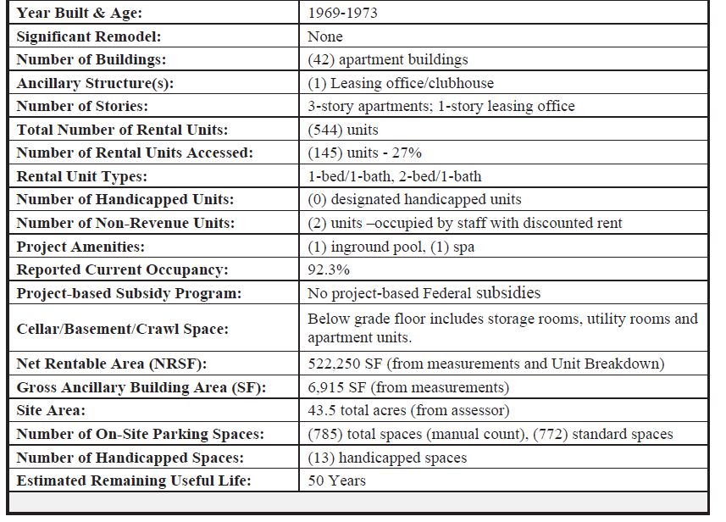

Slide 10
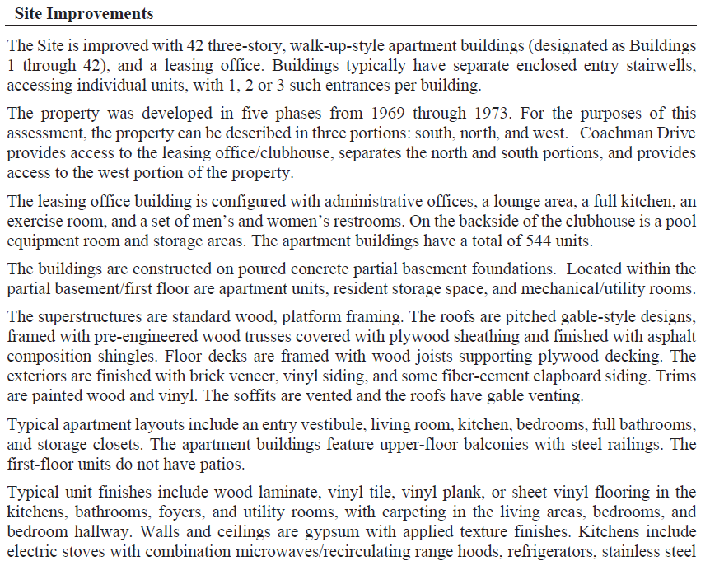

Slide 11
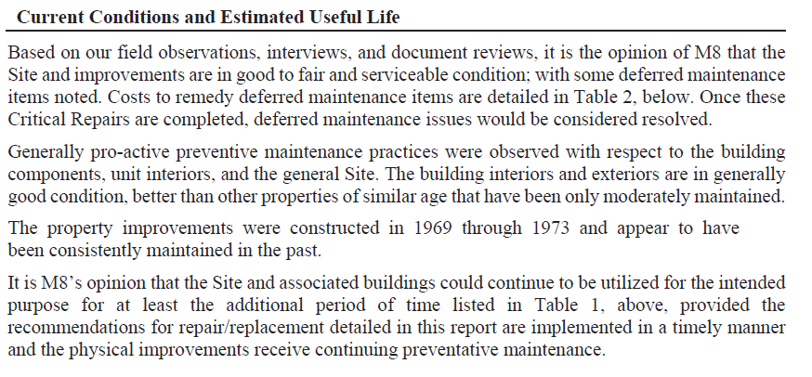
XXXX
XXXXX

Slide 12
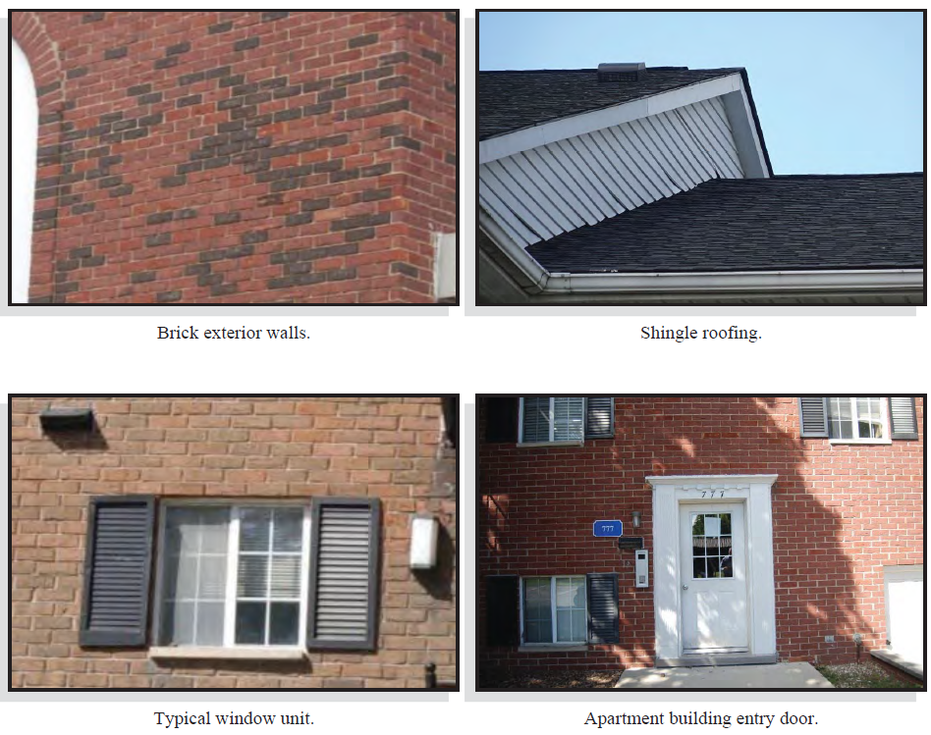

Slide 13
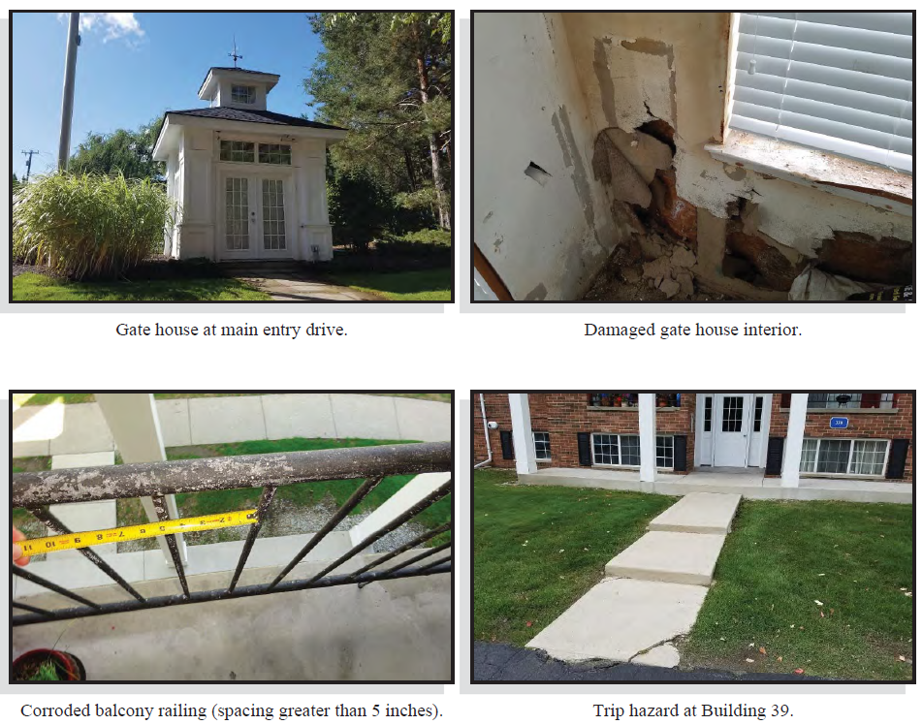

Slide 14
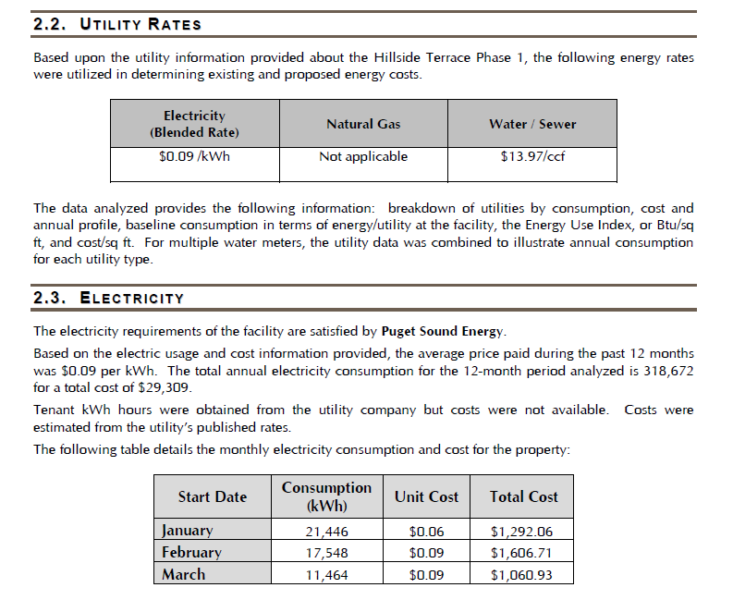
XXXXXXXXXXXX
XXXXXXXXXX

Slide 15
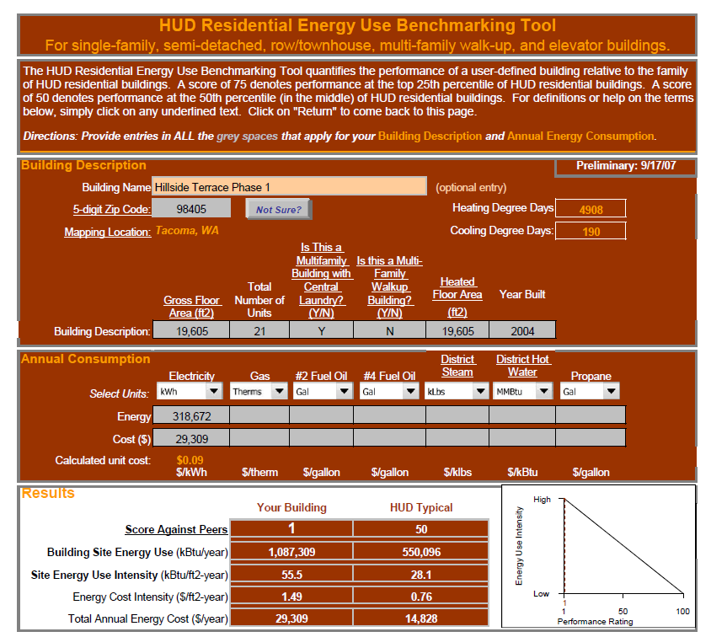
XXXXXXXXXXXXXXX

Slide 16
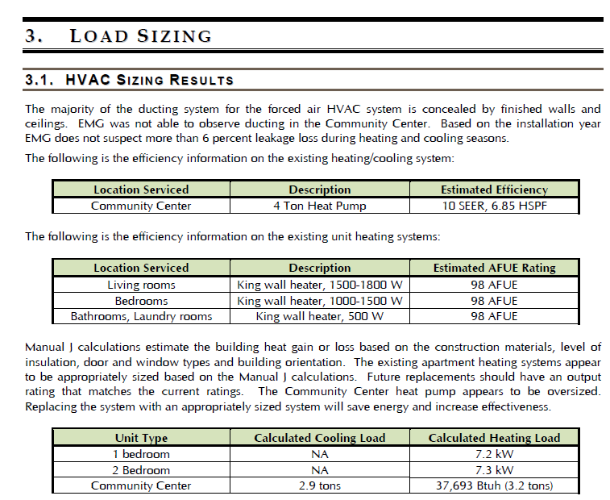

Slide 17
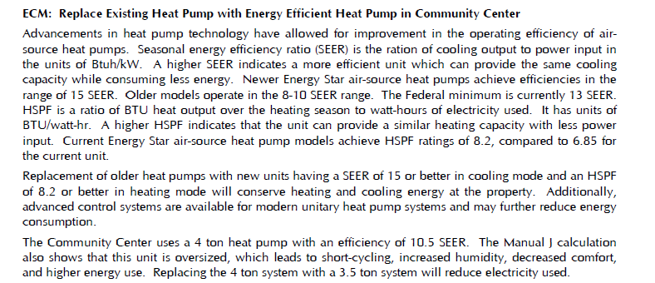

Slide 18
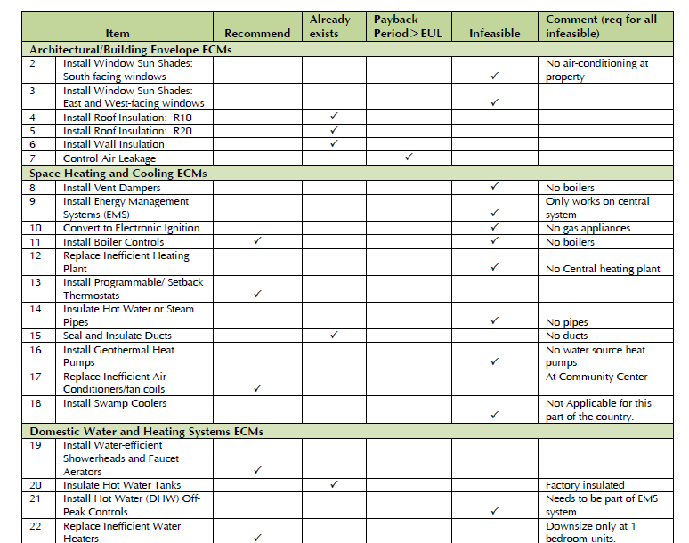

Slide 19
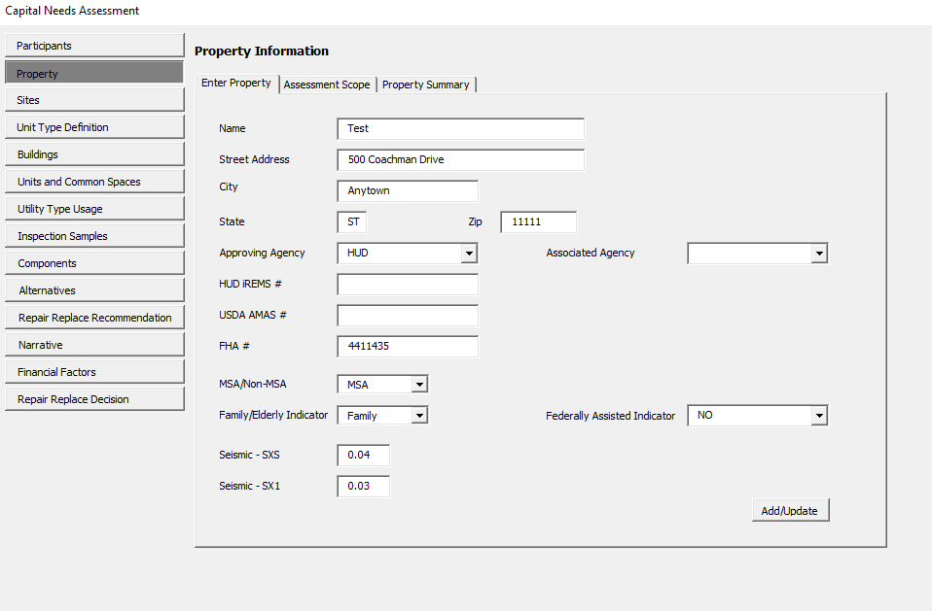
The Assessment Tool
https://hudappswassdev.hud.gov/CNA/

Slide 20
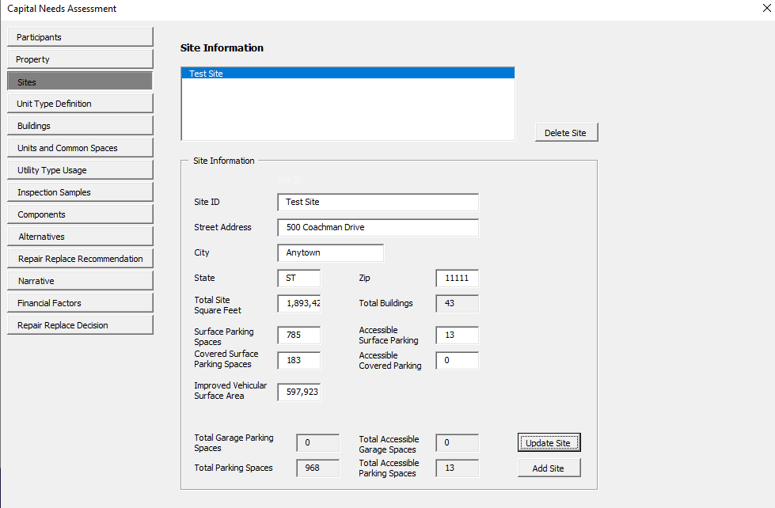

Slide 21
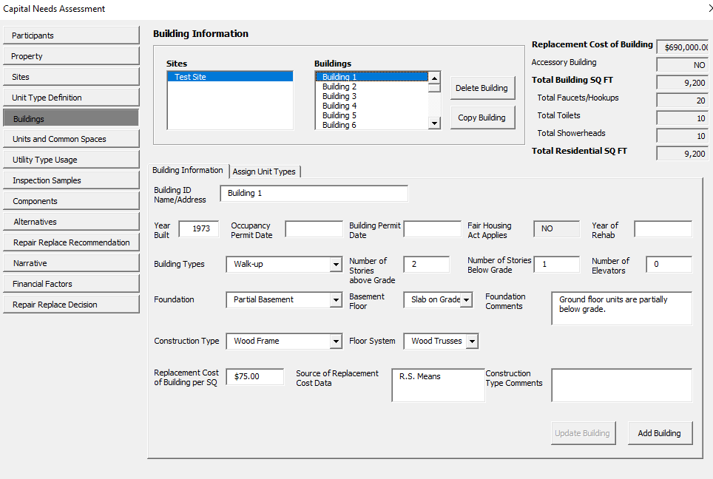

Slide 22
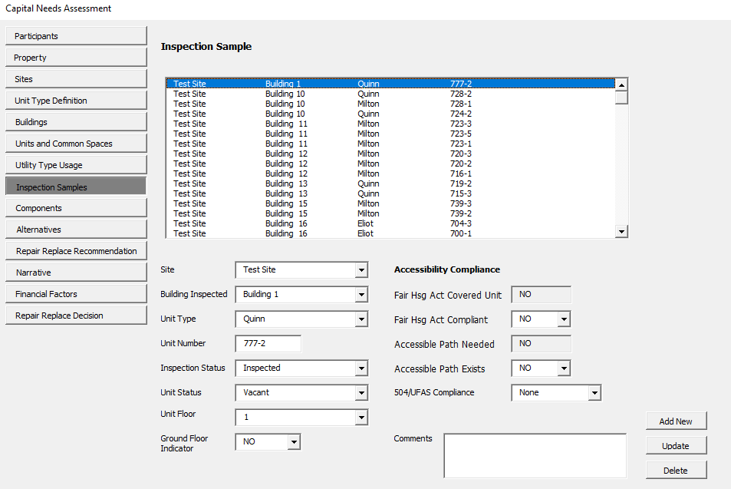

Slide 23
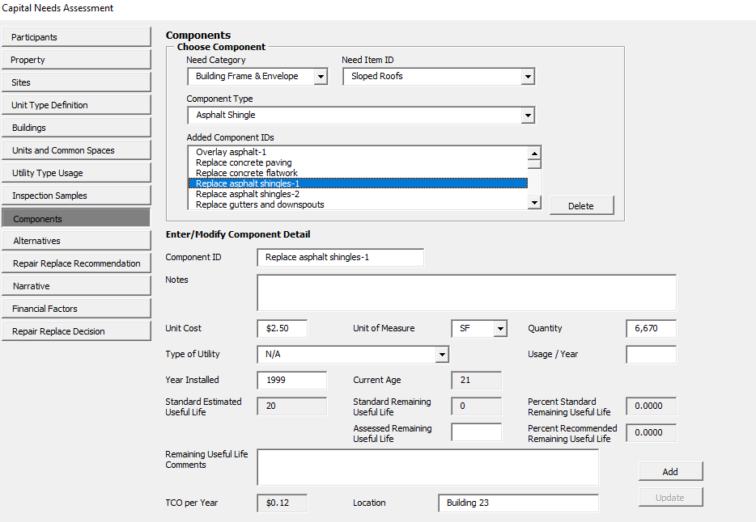

Slide 24
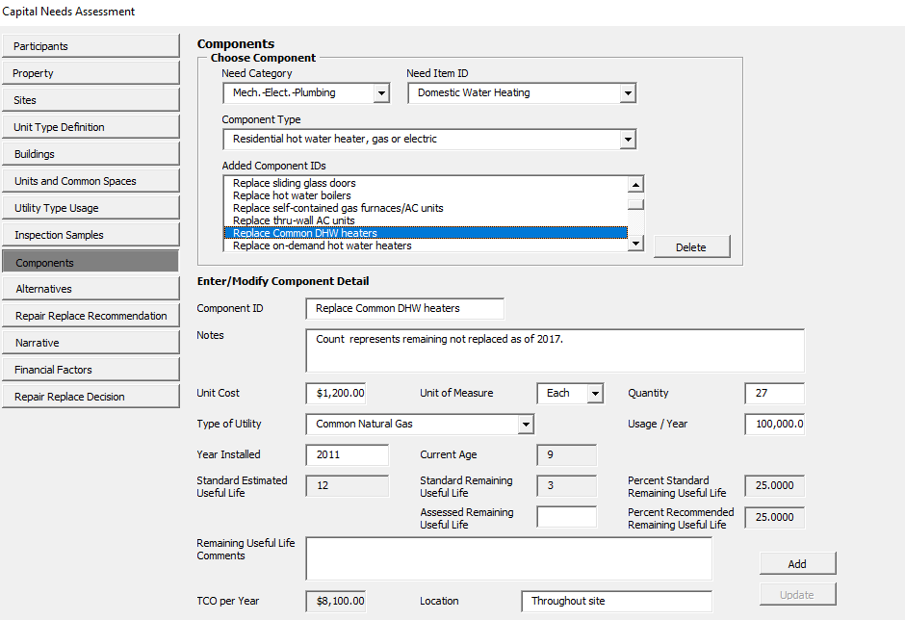

Slide 25
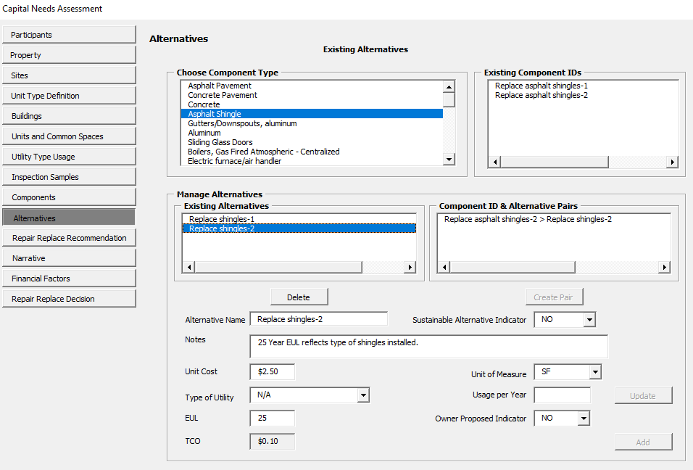

Slide 26
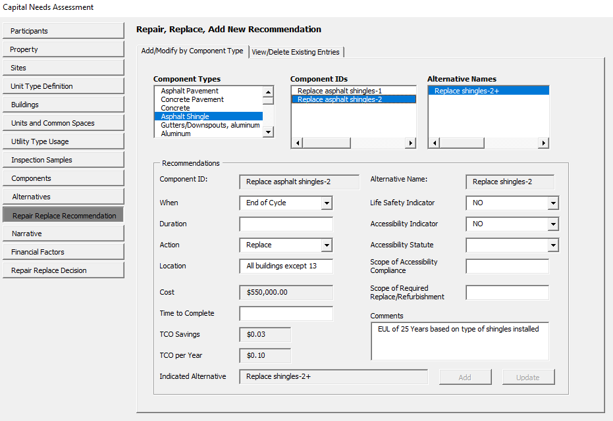

Slide 27
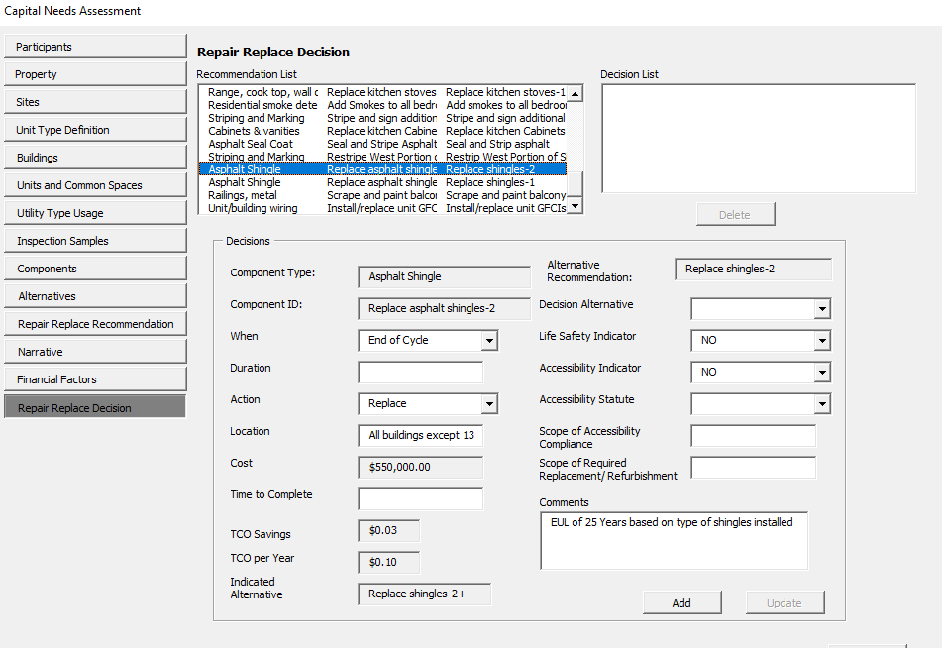

Slide 28
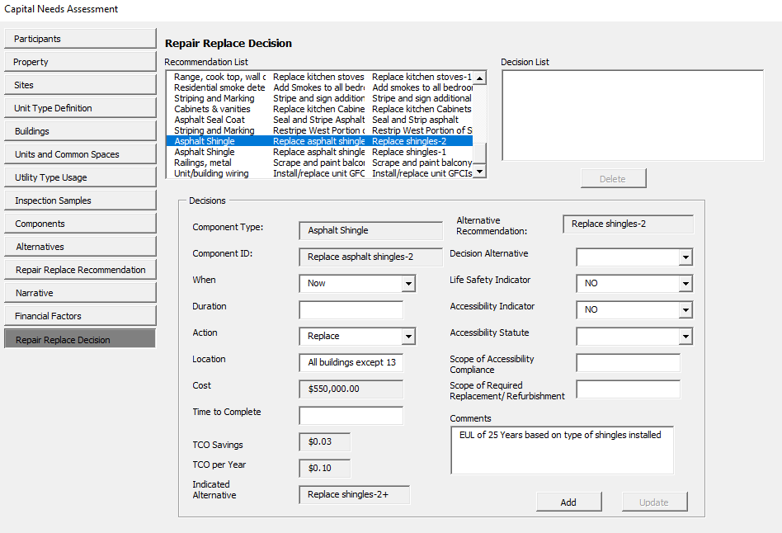

Slide 29
PHA Review and approval of a rad pca
Interacting with Assessors

Slide 30
Preparing for the Site Inspection
Documentation
Maintenance Records
Capital Expenditure Receipts/Ledger
Studies/Reports citing deficiencies
Interview/Onsite Availability
Owner/Manager
Maintenance Staff
Resident Council/Leadership

Slide 31
Operating Philosophy
Current Practices
Schedule of Capital Expenditures
Upgrades/Replacements at Unit Turnover
Funding Sources (Operating vs. Capital)
Desired Upgrades/Replacements
Improvements to the Property
Energy Efficient Upgrades

Slide 32
Open Communication
Owner/Manager
Challenges
Upgrades
General Improvements
Needs Assessor
Best Practices
Industry Knowledge
Site Specific Challenges

Slide 33
The Interplay between the Scope of Work, the ADRR, the IDRR, and the Financing Plan
Pulling it all Together

Slide 34
How does a PCA Impact Project Plans
Sets the RAD development budget and financing plan
Impact of Financing on rehab/upgrades timing:
If LIHTC, maximize up front rehab budget (to maximize basis) and minimize replacement reserve requirements (to enhance loan leveraging)
If debt-only, lender may have requirements for what systems must be replaced up front and which can be funded with on-going replacement reserve draws
If self-financed, can PHA fund rehab up front with existing resources, or does rehab need to be funded primarily though replacement

Slide 35
PCA Identified Rehab Needs
Cost of Rehab

Slide 36
How does a PCA Impact Project Plans
Sets the Required Reserve Balances
All Capital Needs over the 20-Year period must be covered.
Initial Deposit to the Reserve for Replacement (IDRR) account.
Provides a lump sum deposit that covers any potential shortfalls generated by significant single year withdrawals.
Increased IDRR can provide increased cash flow, due to lower ADRRs (As illustrated on the next slide).
Annual Deposit to the Reserve for Replacement (ADRR) account.
Based on available cash flow from annual property operations.
Set in combination with the IDRR in order to maintain a positive balance.

Slide 37
Illustration: Increasing the IDRR to Decrease ADRR (and Increase Cash Flow)
 | No IDRR |  | 50% Reduction in ADRR
20-Year Needs | $ 5,000,000 |  | $ 5,000,000
IDRR | $ 0 |  | $ 2,500,000
ADRR | $ 250,000 |  | $ 125,000

Slide 38
10-Minute Break
Please join us back here at 2:20 PM EST

