Slide 1

Fair Housing and Civil Rights Requirements for RAD Public Housing Conversions
June 17, 2020
Celia Carpentier
HUD Office of Fair Housing and Equal Opportunity
Celia.Y.Carpentier@hud.gov
Alan Kaufmann
HUD Office of Recapitalization
Alan.M.Kaufmann@hud.gov
1

Slide 2
Agenda
Overview of Fair Housing and Civil Rights Laws
Overview of Fair Housing and Civil Rights Reviews of RAD Public Housing Conversions
Processing of RAD FHEO Reviews
2

Slide 3
Fair Housing and Civil Rights Laws

Slide 4
Governing Statutes
Fair Housing Act of 1968, as amended, including the obligation to affirmatively further fair housing
Title VI of the Civil Rights Act of 1964, including Executive Order 13166 (Limited English Proficiency)
Section 504 of the Rehabilitation Act of 1973
Title II of the Americans with Disabilities Act of 1990
4

Slide 5
RAD Upfront Civil Rights Reviews

Slide 6
Front-End Civil Rights Review of RAD Public Housing Conversions
Purpose:
The purpose of HUD’s Front-End Civil Rights Reviews of RAD public housing conversions is to assist PHAs with planning and implementing public housing conversions in a manner consistent with fair housing and other civil rights requirements by conducting an upfront review of certain elements of RAD transactions that have civil rights implications.
Authority:
RAD Notice: In June 2015, the RAD Notice established a front-end civil rights review requirement for public housing conversions.
RAD Civil Rights Notice: The RAD Fair Housing, Civil Rights, and Relocation Notice [H2016-17/PIH 2016-17(HA)], published November 10, 2016, provided clarity regarding applicable fair housing and civil rights requirements and the timing and submission requirements for the front-end civil rights reviews of public housing conversions.

Slide 7
HUD Will Conduct a Front-end Civil Rights Review when:
New construction, whether on a new site or on a current site, in an area of minority concentration
Reduction in the number of units with 2+ bedrooms
Reduction in the number of UFAS units or increase in the number of UFAS units for persons with mobility impairments above 10% of the units at the project and increase in the number of UFAS units for persons with hearing and vision impairments above 4% of the units at the project.
Change in occupancy of the project (e.g., converting a family project to an elderly project)
Relocation that is likely to exceed 12 months
New construction or substantial alteration as those terms are defined under Section 504
Transfers of assistance
FHEO may also, at its discretion, reviews conversions where the project is subject to a Voluntary Compliance Agreement or Conciliation Agreement with HUD or a Consent Decree or Settlement Agreement with the U.S. Department of Justice or HUD, or where the PHA is subject to such an agreement affecting its entire housing portfolio or otherwise related to the converting project, or HUD had identified potential fair housing and civil rights concerns or a history of such concerns.

Slide 8
Comment
Most projects don’t trigger any front-end civil rights review. Although PHAs are currently required to submit the FHEO Accessibility and Relocation Checklist.
Few projects trigger more than one review.
Where applicable, submitting documentation for these reviews should begin early given that the reviews must be completed before a PHA can request a Concept Call (more later!)

Slide 9
Front-End Civil Rights Review of RAD Public Housing Conversions
Approval: HUD’s approval reflects only that the project may proceed through the RAD conversion process; it does not constitute a determination that the project is in compliance with applicable fair housing and civil rights requirements.
Disapproval: HUD’s disapproval is grounds for terminating a CHAP, denying the issuance of an RCC, or denying authority to convert under RAD.
The front-end civil rights reviews shall not be construed to limit other fair housing and civil rights investigations that HUD may conduct.
9

Slide 10
New Construction
Requirement | Elements of Submission
HUD may approve new construction in an area of minority concentration only if: (i) Sufficient, comparable opportunities exist for housing for minority families in the income range to be served by the proposed project outside areas of minority concentration; or (ii) The project is necessary to meet overriding housing needs that cannot be met in that housing market area (e.g., the site is an integral part of an overall local strategy for the preservation or restoration of the immediate neighborhood or the site is in a neighborhood experiencing significant private investment that is demonstrably improving the economic character of the area (a “revitalizing area”). (see 24 CFR 983.57; Appendix III of the RAD Notice) | Use the Site and Neighborhood Standards submission template on the RAD Resource Desk. Determine whether the project is located in an area of minority concentration using the RAD Minority Concentration Tool. If the project is located in an area of minority concentration, submit a narrative along with supporting documentation demonstrating that the project meets one of the exceptions (i.e., sufficient comparable opportunities, overall local strategy, or revitalizing area).

Slide 11
Reduction in Number of Units with 2+ Bedrooms
Requirement | Elements of Submission
HUD’s front-end civil rights review of reduction in the number of units shall consider whether the proposed changes will result in discrimination against a protected class, such as families with children. | Use the Reduction of Units or Change in Unit Configuration Template on the RAD Resource Desk. Demonstrate that the reduction in the number of units will not affect the right to return of any residents or that they have voluntarily accepted an alternative housing option. Analyze the impact of the reduction of units on the PHA’s housing stock and its ability to meet the demand for affordable housing as evidenced by the PHA’s occupancy and waiting list data or other data. Analyze whether the reduction in units would result in a denial of housing to a protected class (e.g., families with children).

Slide 12
Reduction/Increase in UFAS Units
Requirement | Elements of Submission
HUD shall conduct a front-end civil rights review if the RAD conversion results in: A reduction in the number of UFAS accessible units. The creation of units accessible for persons with mobility impairments in excess of 10% of the units at the project and/or the creation of units accessible for persons with hearing and vision impairments in excess of 4% of the units at the project. | Use the Reduction of Units or Change in Unit Configuration Template on the RAD Resource Desk. If the project involves a decrease in UFAS accessible units, demonstrate that this will not affect the right to return of any residents with disabilities or that they have voluntarily accepted an alternative housing option. Note: The project must meet the minimum 5% mobility units/2% hearing and vision units requirement. If the project involves an increase in UFAS accessible units above 10% mobility units/4% hearing and vision units, provide data on local need to justify the increase and analyze whether the change would concentrate individuals with disabilities in a particular property or to exclude individuals with certain types of disabilities from a particular property.

Slide 13
Change in Occupancy
Requirement | Elements of Submission
HUD shall conduct a front-end civil rights review if the RAD conversion results in the implementation of an admissions preference at the Covered Project that would alter the occupancy of the property (e.g., family units converting to elderly units, elderly/disabled units converting to elderly only units). | Use the Change in Occupancy Template on the Resource Desk. A PHA must demonstrate that this change would not result in the involuntary permanent displacement of any resident family. Analyze the impact of the change in occupancy on the PHA’s housing stock and demonstrate that the proposed change in occupancy type is consistent with the demand for affordable housing in its jurisdiction as demonstrated by factors such as the demographics of its current occupancy, the demographics of its waiting list or a market study.

Slide 14
Relocation Exceeding 12 Months
Requirement | Elements of Submission
HUD’s front-end civil rights review shall focus on whether the relocation will result in discrimination on the basis of race, color, national origin, religion, sex, disability, and familial status. | Use the RAD FHEO Accessibility and Relocation Plan Checklist on the RAD Resource Desk. Identify the number of families that will be temporarily or permanently relocated, the demographic characteristics of those families, and the relocation housing options being provided; For any family that will not be able to return to the project, identify the relocation housing options that have been offered to the family and whether they have accepted the offer. For example, if using HCVs, identify where families are likely to relocate.

Slide 15
Accessible Units
Front-End Civil Rights Review | Elements of Review
HUD’s front-end civil rights review of new construction or substantial alteration shall include: Confirming the provision of the minimum number of accessible units required under Section 504 (generally 5% of units accessible for persons with mobility impairments and an additional 2% of units accessible for persons with hearing and vision impairments) and Confirming the PHA is applying the appropriate accessibility standards. | Use the RAD FHEO Accessibility and Relocation Plan Checklist on the RAD Resource Desk. Provide separate numbers for mobility accessible units and hearing/vision accessible units, by bedroom size, and the accessibility standard that will be used (UFAS or HUD’s Deeming Notice/2010 ADA Standards). If the Checklist covers more than one project, provide separate data for each project. If the PHA is subject to a Section 504 remedial agreement that prescribes a higher number of accessible units, this must be reflected in the checklist.

Slide 16
Transfer of Assistance
Front-End Civil Rights Review | Elements of Review
HUD’s front-end civil rights review of transfers of assistance shall consider: The accessibility of the proposed site for persons with disabilities and the ability of the RAD conversion to remediate accessibility concerns. Whether the transfer of assistance would result in assisted units being located in an area with a significantly higher minority concentration. | No template available. Therefore, submission not required at this time. HUD may still review if it receives information that indicates that the proposed transfer of assistance may raise minority concentration or accessibility concerns.
Notes:
Wh

Slide 17
Processing

Slide 18
Processing
PHAs answer the questions on the Concept Call Checklist concerning any proposed changes described in the previous slides.
The Financing Plan grid on the RAD Resource Desk indicate which FHEO categories apply to the transaction.
Upload the appropriate documents on the RAD Resource Desk for each applicable category.
The RAD Resource Desk automatically notifies FHEO when PHAs upload documents on the Resource Desk.
FHEO has 60 calendar days to review the documents.
FHEO will upload a letter of approval or disapproval to the RAD Resource Desk.
If FHEO issues a letter of disapproval, that letter will give the PHA an opportunity to resubmit documents.
NOTES: PHAs must complete and upload the Accessibility and Relocation checklist for every transaction.
Please upload any required FHEO documents ASAP to avoid delays in processing the transaction.
If PHAs have questions at any time during the FHEO process, they should contact Alan Kaufmann (Alan.M.Kaufmann@hud.gov). He meets regularly with FHEO on all FHEO issues for RAD transactions and will address the PHA’s concerns with FHEO.

Slide 19
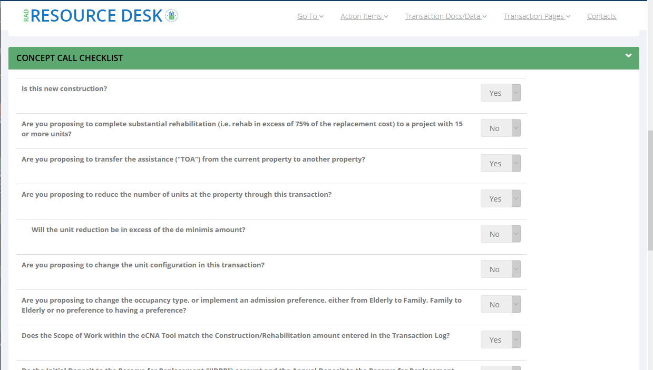
Concept call checklist

Slide 20
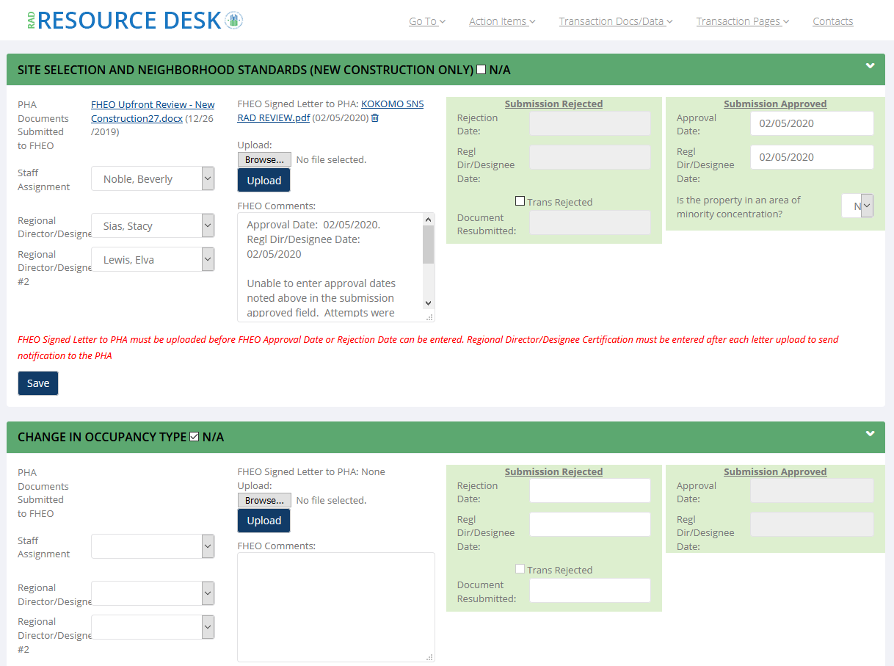
RAD Resource Desk Fair Housing Summary page

Slide 21
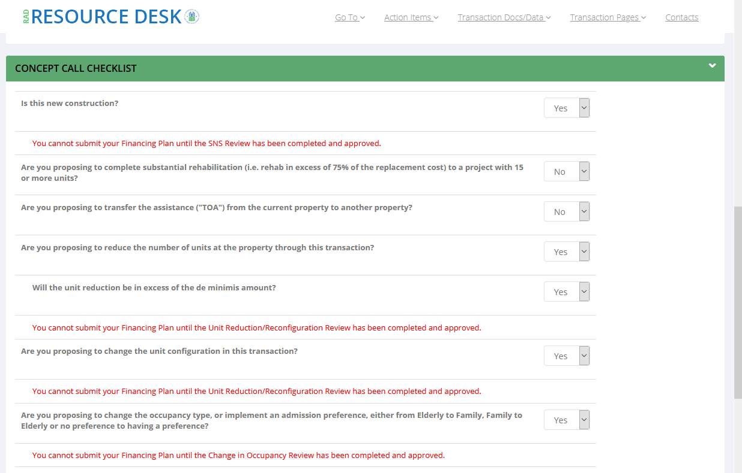
Concept Call Checklist with review reminders

Slide 22
Questions?
22

