Slide 1
CONVERSION STRATEGIES
Financing, Site Aggregation, Portfolio Awards
Kara Williams-Kief
Office of Recapitalization
Kara.S.Williams-Kief@hud.gov
June 17, 2020

Slide 2
INTRODUCTION
Basic Underwriting Test:
The converting project must demonstrate that it can meet the 20-year capital needs identified through a third-party Capital Needs Assessment (CNA) and otherwise generally show cash flow of $12 pupm or, in the case of leveraged transactions, a debt coverage of at least 1.11.
To meet those needs, there are three different financing strategies:
No -Debt
Debt-only
Tax Credit

Slide 3
BY THE NUMBERS
4% LIHTC: 29.30%
9% LIHTC: 8.80%

Slide 4
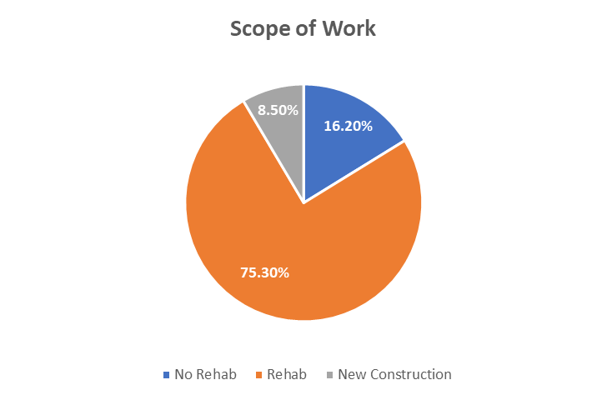
BY THE NUMBERS

Slide 5
NO-DEBT TRANSACTIONS

Slide 6
DEFINITION
No-debt means a PHA is not utilizing any permanent financing to support the transaction.
This does not necessarily mean no work is being completed.

Slide 7
SOURCES OF FUNDING
No-debt transactions can have any number of funding sources, including:
Public housing funds
Local grants
Other “soft” (subject to cash flow) funds

Slide 8
USE OF PUBLIC HOUSING FUNDS
PHAs are permitted to use available public housing funding as a source of capital in the development budget to support conversion rehabilitation, new construction, as well as to increase initial contract rents.
The public housing funds must be identified in the Financing Plan and RCC.
Public housing funds cannot be used to support a transaction following closing.

Slide 9
USE OF PUBLIC HOUSING FUNDS
Operating Reserves
Capital Funds
Replacement Housing Factor (RHF) funds
Demolition and Disposition Transitional Funding (DDTF)
S18 Disposition Proceeds

Slide 10
RESTRICTIONS ON PUBLIC HOUSING FUNDS
If PH funds are contributed as a loan, they must be structured as a “soft” second mortgage payable from project cash flow.
When closing out of the Public Housing program, the PHA can (should!) bring over ALL remaining public housing funds.
Financing proceeds will not be allowed when public housing Capital, Operating, or MTW funds are used (unless it is the last public housing units for a PHA).

Slide 11
STREAMLINED “SMALL PHA” CONVERSIONS
A type of ‘no-debt’ transaction.
PHAs with 50 or fewer units are eligible.
A PHA is only eligible if it is not doing any rehab work outside of critical repairs.
Requires a modified Financing Plan Submission
Does not require a Capital Needs Assessment or eTool – relies on a PHA Board certification as to the condition of the project.

Slide 12
MOVING TO WORK FLEXIBILITIES
Moving-to-Work (MTW) Agencies may use certain public housing and voucher funds authorized under their funding flexibilities (“MTW funds”) as an additional source of capital to support conversion.
MTW funds, whether provided as a loan, a grant, or a capital contribution, must be identified in the Financing Plan.
MTW Agencies may also use their authority to augment the conversion’s RAD rents.

Slide 13
FUTURE RECAPITALIZATION
A PHA can covert as a no-debt transaction now and refinance and/or recapitalize the project post-completion certification.
Any future post-conversion approvals to refinance and/or recapitalize will be provided by PIH (PBVs) or Housing (PBRA).

Slide 14
DEBT ONLY TRANSACTIONS

Slide 15
DEFINITION
A “debt only” transaction is one that includes permanent debt but excludes the use of Low-Income Housing Tax Credits (LIHTCs).
Permanent debt (aka “hard debt”) will have required monthly debt service payments:
Commercial/Conventional Lenders
FHA-Insured Mortgage Lenders
PHAs are prohibited from using Public Housing Funds as hard debt.

Slide 16
BENEFITS OF LEVERAGING DEBT
PHAs may choose to take on debt either to:
Increase the amount of capital available to complete required repairs.
Increase the amount of capital available to complete larger scopes of work.
Fund reserves.
Pay-off existing debt such as CFFP and EPC

Slide 17
BASICS OF USING DEBT
Conversions are eligible for financing from private and public lending sources.
Financing must be subordinate to the RAD Use Agreement- this includes existing mixed-finance projects.
Many sources of funding at the seller, local, state, and federal level may be structured as grants or as cashflow notes.

Slide 18
TYPES OF DEBT
Traditional Commercial Lenders
CDFIs
GSEs
Federal Home Loan Banks
CDBG
HOME Funds
Housing Trust Funds
State and Local Funds
Seller Note/Financing
Private Foundation Financing
FHA-Insured Mortgage

Slide 19
PERMANENT DEBT REQUIREMENTS
Permanent Debt Terms:
Fixed rate of interest, for a fixed term, fully amortized over no more than 40 years.
No balloon payment until after the earlier to occur of a) expiration of the term of the HAP Contract or b) 17 years from the date of the permanent debt financing.
Not have a debt service coverage less than the higher of 1.11.

Slide 20
FHA-INSURED DEBT
FHA mortgage insurance provides high leverage and long-term, fully amortizing fixed-rate financing at competitive interest rates.
See Notice H 2012-20.
The two most common FHA products are:
223(f)
224(d)(4)
Risk sharing programs offered by state housing financing agencies, Freddie Mac, and/or Fannie Mae.
Secondary financing, tax credits, and other public sources can be used in conjunction with FHA-insured financing and risk sharing programs.

Slide 21
ACQUISITION PROCEEDS
A PHA is permitted to receive cash acquisition proceeds in excess of any seller take-back financing only if the PHA is not using public housing Capital, Operating, or MTW funds as a source of funds for the transaction.
All such proceeds must be used for Affordable Housing Purposes.
Until expended, the PHA must place the proceeds in an account subject to a HUD-51999, General Depository Agreement.

Slide 22
TAX CREDIT TRANSACTIONS

Slide 23
TAX CREDIT FINANCING
PHAs may choose to use tax credit financing because:
The capital needs of the property are too great, and debt alone will not provide enough funds to complete needed repairs.
Tax credits can generate excess equity.

Slide 24
TYPES OF TAX CREDITS
9% Low Income Housing Tax Credits
Annual; Competitive
4% Low income Housing Tax Credits
Rolling; Non-Competitive
Historic Tax Credits
Opportunity Zone Tax Credits

Slide 25
TAX CREDIT FINANCING
Excessive annual demand for allocations of 9% LIHTCs.
States routinely do not fully allocate their supply of 4% as-of-right credits coupled with tax-exempt bond financing.
PHAs are encouraged to assess local demand and supply considerations.
PHAs must indicate in its RAD application if it intends to use tax credits, but there is no requirement to have secured these credits prior to applying to RAD.
Approval of Allocation is required for the RAD Approval Memo and RCC.

Slide 26
EXISTING MIXED-FINANCE PROJECTS
Public Housing mixed‐finance projects were previously developed in conjunction with low‐income housing tax credits and therefore involve existing outside investors, owners, and lenders.
Mixed-finance conversions can be no-debt, debt only, or tax credits.
Existing lenders must subordinate to the RAD Use Agreement.

Slide 27
SITE AGGREGATION

Slide 28
PROJECT DEFINITION
The RAD Notice defines ‘project’ as follows:
“For purposes of determining a RAD transaction, a ‘project’ is a structure or group of structures that in HUD’s determination are appropriately managed as a single financial asset. In most cases, this corresponds to a grouping of residential units that are managed and marketed as a single entity and are geographically proximate. In determining whether multiple structures constitute a project, HUD will take into account types of buildings, occupancy, location, market influences, management organization, financing structure or other factors as appropriate.”

Slide 29
SITE AGGREGATION
It is IMPERATIVE that a PHA consult the RAD team prior to financing being secured to receive conditional approval on the site groupings.

Slide 30
SITE AGGREGATION
Recap will use the standards found in PIH-Notice 2006-10 to determine what constitutes a single manageable, marketable entity.
Non-contiguous site of 80 or more units that is not proximate to another site should be expected to be its own project and to be financed as a separate transaction.

Slide 31
SITE AGGREGATION
FINANCING PLAN
Site Map for Proposed Grouping
Map of Remaining PH Units
Management & Oversight Narrative

Slide 32
SITE AGGREGATION
Recap will determine if the request is reasonable and necessary and to consider whether other groupings might be more appropriate
For any FHA or PBRA transaction, the PHA will need to obtain separate approval from FHA and OAMPO

Slide 33
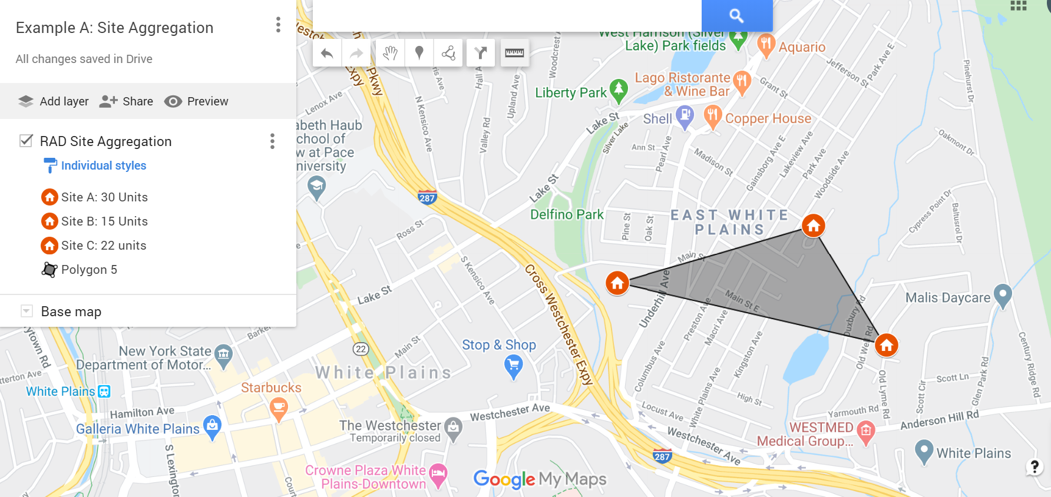
SITE AGGREGATION
Less than 80-units
No physical barriers
Less than 1-mile

Slide 34
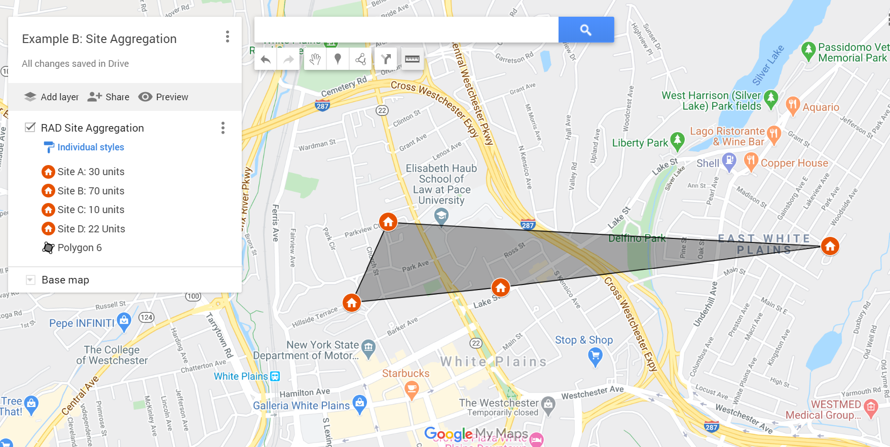
SITE AGGREGATION
Less than 80-units
Physical barriers
More than 1-mile

Slide 35
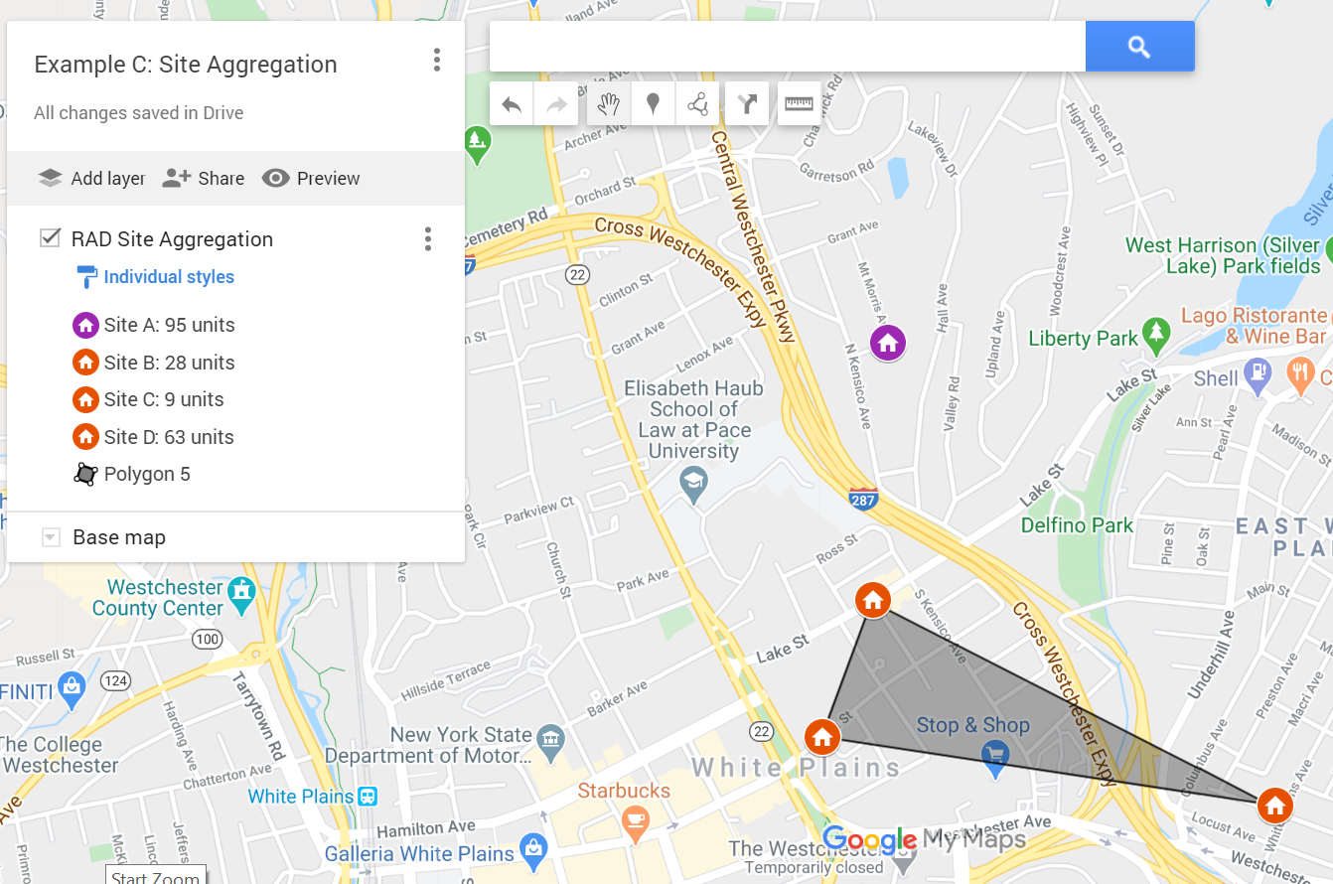
SITE AGGREGATION
Single site more than 80 units
Site grouping of less than 80 units
Physical barriers
Less than 1-mile

Slide 36
PORTFOLIO AWARDS

Slide 37
FROM ‘MULTIPHASE’ TO ‘PORTFOLIO’ AWARDS
Prior versions of the Notice distinguished Multi-Phase Awards from Portfolio Awards.
With REV-4, PHAs that wish to implement a Multi-Phase rehabilitation or redevelopment of a public housing site may reserve authority to do so under the Portfolio Award structure.

Slide 38
DEFINITION
A Portfolio Award allows a PHA to reserve RAD conversion authority for a set of projects (including for multiple phases of a large-scale redevelopment effort and for planned projects) and that locks in the applicable contract rent in the year of application.

Slide 39
PORTFOLIO AWARDS
With REV-4, PHAs may reserve conversion authority under the Portfolio Award structure:
Greater flexibility in planning conversions. PHAs may substitute projects in the portfolio award, and switch projects between the active and pending portions of the portfolio
Multi-phase awards have been automatically converted to Portfolio Awards.
9/30/2024 application deadline for final project conversion.

Slide 40
PORTFOLIO AWARDS
Recap wants to see PROGRESS!
HUD may revoke RAD conversion authority provided under the Portfolio Award for all projects where a CHAP has yet to be issued.

Slide 41
FINAL THOUGHTS
Pulling together financing can be complicated!
Development Partners (turn-key or fee) are recommended where PHA does not have the experience/capacity.
Understand the Capital Needs of the project.
Identify sources of funds such as debt and equity to carry out the necessary capital needs.
Strategize what the best site aggregations are for financially viable conversions.
Manage the reserved units in a Portfolio Award to efficiently utilize available units.

Slide 42
Next Session:
Conversion Strategies | Case Study Discussion
Kara Williams-Kief, HUD Office of Recapitalization
Robert Robinson, Federal Practice Group, LLC

