Slide 1
A Case Study:
Conversion Strategies
“A CNA and a PHA walk into bar…”
Kara Williams-Kief |Office of Recapitalization | kara.s.williams-kief@hud.gov
Robert Robinson | Federal Practice Group | robert.robinson@fedpg.com
June 17, 2020

Slide 2
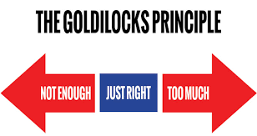
Focus
The CNA drives what financing is necessary to complete the capital needs.
One size doesn’t fit all!

Slide 3
Case Study Details
Project is in Georgia
50-units within 25 one-story buildings
Built on a 7-acres; suburban
Mix of 1-, 2-, and 3-bedroom units
Built in 1970
Minor upgrades over the years
Overall, PHA believes the asset has been well maintained

Slide 4
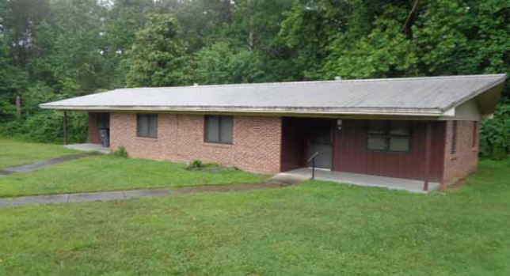
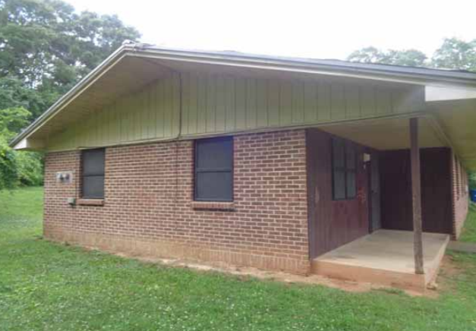
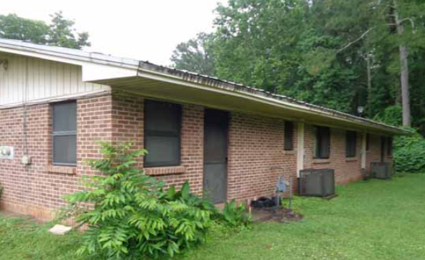
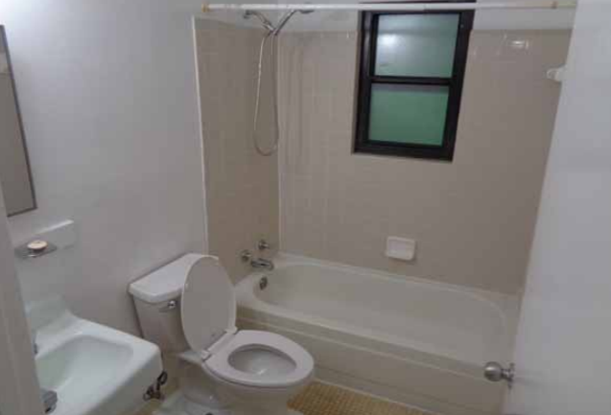
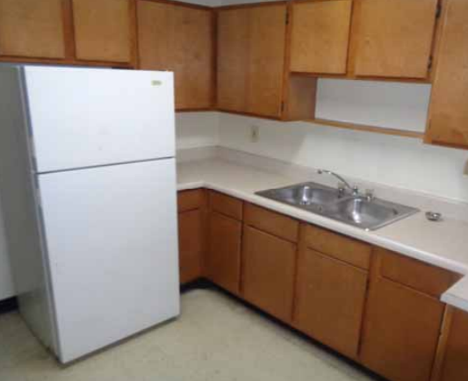
Case Study Photos

Slide 5
Case Study: PHA Initial Goals
PHA would like to convert this project via RAD.
PHA anticipates that there will be some required rehab to address capital needs.
PHA believes at this stage, the required capital needs can be completed with PHA Funds only.
PHA would like to have the R4R annual deposits at $300 p/unit so the annual NOI is sufficient.

Slide 6

PHA Funds for Conversion
Cap Funds $90k
Op Funds $150k

Slide 7
The Capital Needs Assessment
20-Yr Schedule | Year 0 | Year 1 | Year 2 | Year 3
Capital Needs | $1,000,000 | $150,000 | $125,000 | $225,000
IDRR | $100,000 | - | - | -
ADRR | - | $15,000 | $15,000 | $15,000
Capital needs at conversion are higher than originally anticipated.
Capital needs in the immediate years after are also higher than anticipated.
An IDRR will need to be funded to keep annual reserve deposits at $300 p/unit.

Slide 8

WHAT SHOULD THE PHA DO?!

Slide 9
Option 1: No Debt
PHA has $240,000 in Public Housing funds that must cover:
  Immediate Capital Needs of $1.0M
  Fund the $100,000 ADRR
PHA has $500k of additional Capital Needs within first 3 years.
Not financially viable as a no debt conversion.

Slide 10
Option 2: Debt Only
Increase the amount of capital available to complete required repairs and additional scope items.
  Debt + public housing funds + any cash flow notes
  Easily cover capital needs at conversion and maybe complete some capital needs in years 1-3 now
Fund reserves.
  Help cover the high IDRR to keep the ADRR lower
Maintain PHA ownership.
  PHA Instrumentality
Take a developer fee.
  PHA can receive a portion of the developer fee to go towards other affordable housing ventures

Slide 11
Option 2: Cash Flow
Goal: $1,500,000 in Rehab
Loan Amount: $1,000,000
Rate: 3.00%
Term: 30 Years
Will require additional soft cash flow financing - including Op and Cap Funds.

Slide 12
Option 3: Tax Credits
Add equity to the project to increase the amount of capital available to complete required repairs.
  4% or 9%; dependent on how the project scores
  Scope of work could address all the 20-year capital needs of the property
Fund reserves.
  Help cover the high IDRR to keep the ADRR lower.
Take a developer fee.
  PHA can receive a portion of the developer fee to go towards other affordable housing ventures.
Bring on additional expertise and guarantors
  Tax Credit Partnership
  Higher transaction, legal and organizational costs

Slide 13
Option 3: Cash Flow
Goal: $5,000,000 in Rehab
Proforma doesn’t change!
Loan Amount: $1,000,000
Rate: 3.00%
Term: 30 Years
Will (most likely) require tax credit equity

Slide 14
Evaluating the Options
Debt Only
Sufficient NOI
Available Soft Financing
Tax Credits
Long-Term Needs
Must meet HFA U/W Requirements
Tax Credit Partnership
Less Lender Compliance Requirements
SAE Ownership
Less Transactional Costs
Immediate and Short-Term Needs in Earshot
Higher Transactional Costs
Tax Credit Program Compliance Requirements

Slide 15
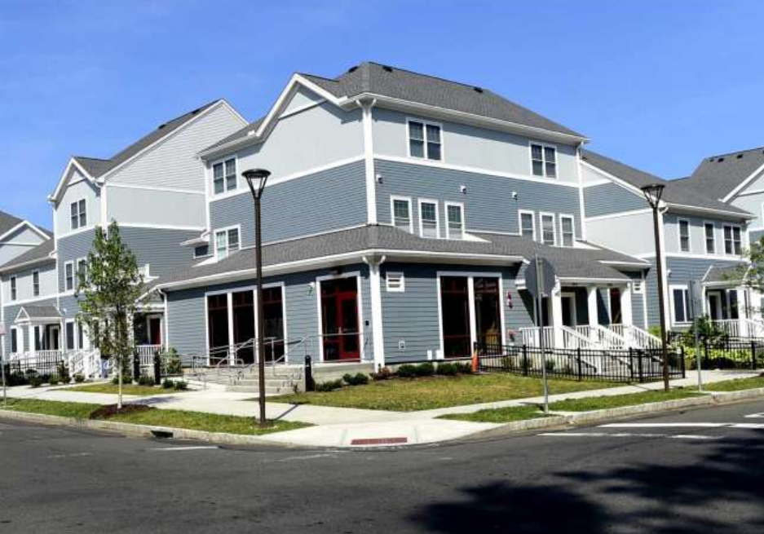
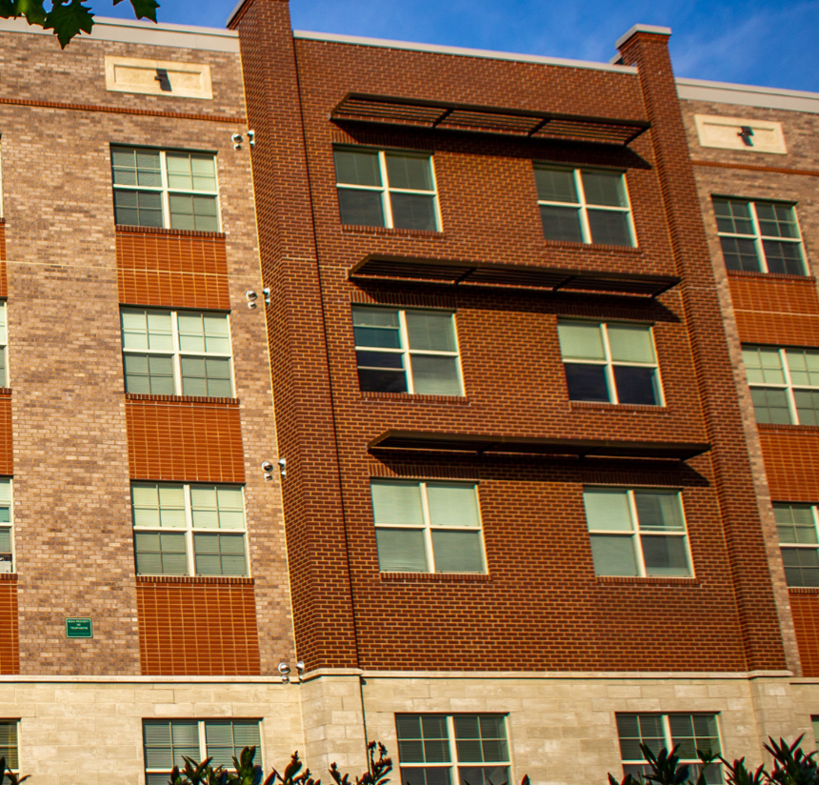
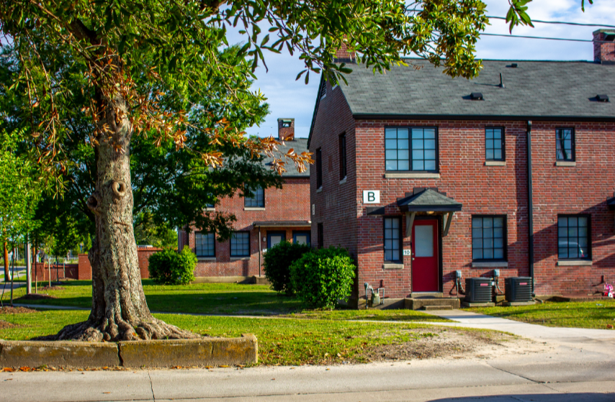
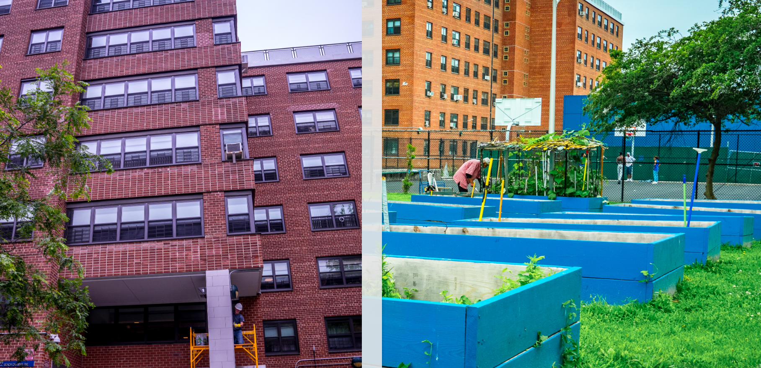
The Results: Exterior

Slide 16
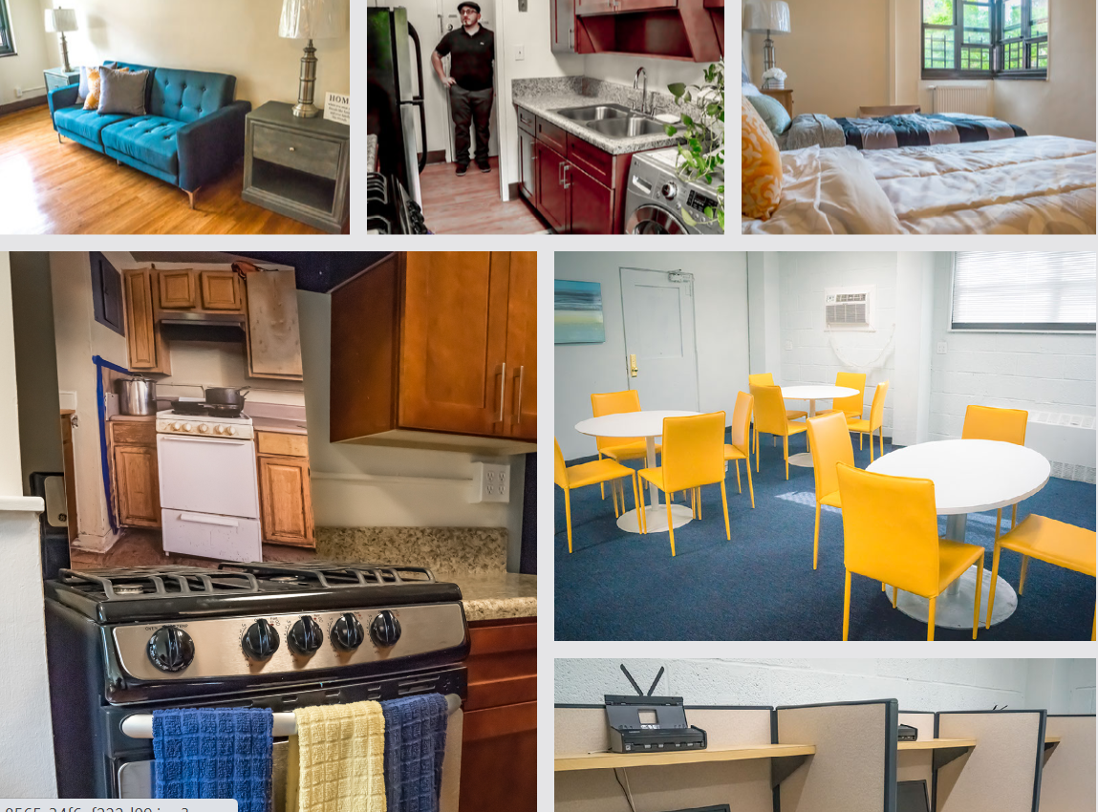
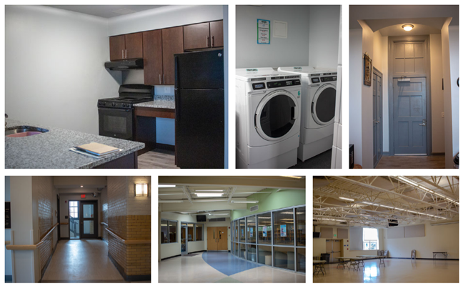
The Results: Interior

Slide 17
Thank You!
https://www.hud.gov/RAD/news/photoessays

Slide 18
Next Session:
FHEO Approvals
Celia Carpentier, HUD Office of Fair Housing and Equal Opportunity
Alan Kaufmann, HUD Office of Recapitalization

