Slide 1
Preparing for the Financing Plan The Building Blocks for a Successful Submission
RAD 2020 Awardee Virtual Training
Day Three | June 18, 2020
Presenters: Alan Kaufmann & Seema Radhakrishnan
Office of Recapitalization
Notes:
Seema

Slide 2
AGENDA
Milestones and Building Blocks: Making Decisions and Planning your transaction
Preparing for your Concept Call
After the Concept Call: Submitting a successful Financing Plan
Questions
Notes:
Seema

Slide 3
MILESTONES & BUILDING BLOCKS

Slide 4
MILESTONES
CHAP Award
Concept Call
Financing Plan Submission
Closing
RCC Issued
All Financing Plans due within 270 days of CHAP.
Extensions permitted, contingent on reasonable justification.
If extension exceeds 6 months, PHA must hold or show evidence of an additional resident meeting.

Slide 5
Key Building Blocks
What to get done EARLY:
PIH Approvals
Financing Sources
CNA etool
Environmental Review
Upfront Civil Rights Reviews

Slide 6
PIH Approvals
EPCs and CFFP
PIC Removals and Non-Dwelling Certification
Annual Plan
PBV Independent Entity
Bottom Line: While Recap will underwrite the transaction, we also work with our partners in PIH, and we need for them to be comfortable with the path forward.

Slide 7
Financing Sources
The templates are designed to tell you precisely what you need to submit:
No Debt
Debt-Only
Tax Credit
Streamlined RAD
Bottom Line: The RD makes life easy and will offer prompts on how to fill out the FP grid based on the financing sources in place.

Slide 8
Environmental Reviews
An environmental review is the process of reviewing a project and its potential environmental impacts to determine whether it meets federal, state, and local environmental standards.
It is intended to ensure that the proposed project does not negatively impact the surrounding environment or have an adverse effect on residents’ health and safety.
An environmental review must be performed before any funds, regardless of source, are committed to a project.
RAD follows Chapter 9 of the MAP Guide.
Notes:
Seema

Slide 9
Environmental Review: Key Components
Phase I Environmental Site Assessment (ESA)
Types:
Part 58
Part 50
HEROS Approval:
Recap
Partner
Notes:
Seema

Slide 10
Part 50 vs. Part 58
RAD Conversions are either a Part 50 or Part 58
58.11(c) allows for HUD to ‘take over’ a Part 58 review due to timing or capacity issues.
This request must be made in writing and submitted to HUD no later than at the time of the RAD Concept Call.
Description | Type of ER | Reviewer
PBRA Non-FHA | Part 50 | RAD TM
PBRA FHA Non-Risk Share | Part 50 | FHA Production
PBRA FHA Risk-Share | Part 50 | RAD TM
PBV Non-FHA | Part 58 | Responsible Entity
PBV FHA Risk-Share | Part 58 | Responsible Entity
PBV FHA Risk-Share | Part 58 | State HFA or RE
Notes:
Seema

Slide 11
HEROS
HUD’s Environmental Review On-Line System (HEROS)
RAD Transaction Managers & FHA Production staff, are required to use HEROS to complete all Part 50 reviews.
Pursuant to the RAD Notice (Revision 4), it is now mandatory for all Part 50 ERs to be submitted in HEROS directly by the consultants, lenders, PHAs, or other Partners. We HIGHLY recommend that Partners input into HEROS.
Reminder: Radon testing is now required on ALL RAD transactions!
2020 ERR Quick Reference Guide can be found on the RAD Resource Desk
Notes:
Seema

Slide 12
Upfront Civil Rights Reviews
Unit Reduction
Unit Reconfiguration
Change in Occupancy
New Construction (SNS Review)
Relocation
Notes:
Alan

Slide 13
THE CONCEPT CALL

Slide 14
What is HUD looking for?
The purpose of the Concept Call is two-fold:
Demonstrate that the plans are sufficiently advanced to warrant review by HUD, and
Subsequently, invite the PHA to submit a Financing Plan if it is consistent with the project plans.
Note: All Financing Plans are due within 270 days of CHAP. Extensions permitted, contingent on reasonable justification and additional resident meeting if extension exceeds 6 months.
Notes:
Seema

Slide 15
The Process
Prior to submitting a Financing Plan, a PHA must request a “Concept Call” with HUD via the RAD Resource Desk.
HUD has fully implemented the Concept Call for any Financing Plan submitted on or after October 7, 2019.
RD will send automatic reminders 60-days and 30-days prior to Financing Plan due date if no Concept Call has been requested.
Recap will invite HUD PIH staff as well as FHA production, if applicable.
PHA will describe the conversion plan and demonstrate that the plans are sufficiently advanced to warrant review by HUD.
HUD will subsequently invite the PHA to submit a Financing Plan.
Notes:
Seema

Slide 16
Concept Call Log

Slide 17
PRIOR TO THE CALL – ITEMS TO SUBMIT
The only FP documents that are required at Concept Call are:
DDA #
Conversion Overview
RPCA or eCNA Tool & Scope of Work
Tool validation
Flags report
ADRR/IDRR consistent with Transaction Log.
Environmental Review
Part 58 – Not required at time of Concept Call, but must be uploaded by FP submission.
Part 50 – Must be completed in HEROS at time of Concept Call (including Radon report)
Accessibility & Relocation Checklist must be uploaded.
Site Selection and Neighborhood Standards (if Applicable)
Change in Unit Configuration or Unit Reduction (if Applicable)
Change in Occupancy Type (if Applicable)
The Transaction Log must be completed
Notes:
Seema

Slide 18
Tips for a smooth Concept Call
Complete the Concept Call checklist first! Do not jump into the Financing Plan grid.
Clear plan, actions steps and timelines – A robust Conversion Overview is KEY!
Utilize the tools and resources on the Resource Desk. They are there to help, not hinder!
Resident Meetings – Another resident meeting is required prior to submitting the FP. No exceptions!
Not submitting the necessary items prior to the Concept Call = Not being invited to submit the FP.
Note: Please remember, this is not a Financing Plan review.

Slide 19
AFTER THE CONCEPT CALL:
SUBMITTING THE FINANCING PLAN

Slide 20
HUD UNDERWRITING: KEY ASPECTS
Development Budget
Comprehensive and balanced sources/uses.
Line items properly broken down.
Construction line item must match eTool.
Proposed Financing
Sources of financing – Capital funds, hard debt, soft debt, LIHTC equity, grants, etc.
Commitment letters – Dated no later than 60 days prior to FP submission
Operating Pro-Forma
Feasibility benchmarks – Rents, vacancy & bad debt not to exceed 5%.
PILOT – Legal opinion (or documentation of R/E tax estimate if no PILOT).
Operating expenses – We compare operating expenses with the three-year average. Although we fully expect most transactions to operate for less than historical levels, we will look for additional documentation if expenses are projected at less than 85% of three-year average.
Cash flow - $12 PUPM (non-leveraged); 1.11x DSCR (leveraged).
Notes:
Seema

Slide 21
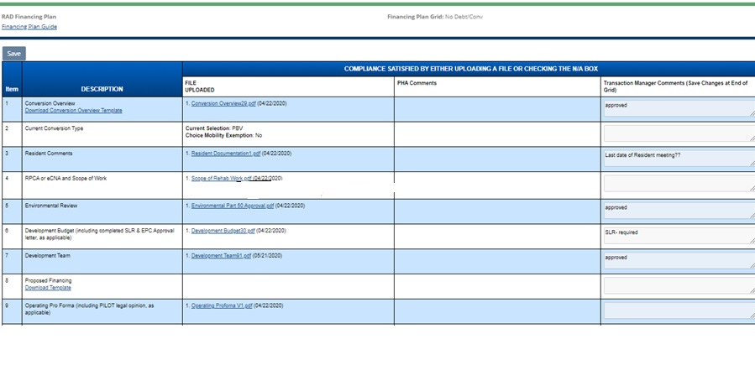
HUD UNDERWRITING
Notes:
Seema

Slide 22
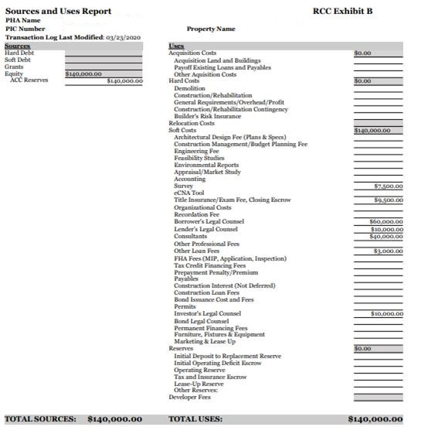
HUD UNDERWRITING
Notes:
Seema

Slide 23
RAD & Capital Funds
Capital Funds: 4 possible uses in RAD transactions:
Predevelopment Expenses
Rent Boost
Housing Assistance Payments in the Initial Year-BLI 1503
Development Expenses-BLI 1504
Obligation End Date Extensions
Final Closing on Last Public Housing Units
Notes:
Alan

Slide 24
Questions? Alan Kaufmann - Alan.M.Kaufmann@hud.gov Seema Radhakrishnan – Seema.Radhakrishnan@hud.gov RAD Resource Desk - resourcedesk@radresource.net

Slide 25
10-minute Break
Please join us back here at 2:05 PM EST

