Slide 1
Requesting Technical Assistance
RAD 2020 Awardee Virtual Training
Day One
June 16, 2020
Presenter: Greg Byrne

Slide 2
Availability
Awardees may request technical assistance once they leave the ‘Launch Period.’
The Launch Period lasts for about the first 4 months following an agency’s initial CHAP award. During this period, Recap assigns an Initial Technical Assistance Provider to assist the PHA with ‘on-boarding’, which includes:
Introduction to the RAD Resource Desk,
Review of Initial Project Plans,
Milestones, and
Basic RAD program rules

Slide 3
Eligible Activities
These include, but are not limited to,
Discussing property or portfolio conversion plans
Reviewing/interpreting third party reports (CNA e-tool, environmental)
Financing the conversion
Understanding general financing plan submission requirements,
Help with general RAD Resource Desk website navigation/functionality
Assembling the development team
Project feasibility
Difference between TA and general Help Desk program questions:
Ask the Help Desk: Where do I find the “submit” button on the Financing Plan Page?
Ask for TA: I need help determining how much I should put into the ADRR vs the IDRR.

Slide 4
TA Request Examples
Financing the Conversion: Single Family Homes recently received a Capital Needs Assessment report (e-tool). The financial projection shows ending balances (after R4R deposits) becoming lower than the floor after year 10. The Authority plans to increase the annual deposits to replacement reserves, but also wants to understand how it would show recapitalization (around years 7-8) in case it chooses to finance the work in later years through 4% LIHTC and tax-exempt bonds.
Notes:
Single Family Homes recently received a Capital Needs Assessment report (e-tool). The financial projection shows ending balances (after R4R deposits) becoming lower than the floor after year 10. The Authority plans to increase the annual deposits to replacement reserves, but also wants to understand how it would show recapitalization (around years 7-8) in case it chooses to finance the work in later years through 4% LIHTC and tax-exempt bonds.

Slide 5
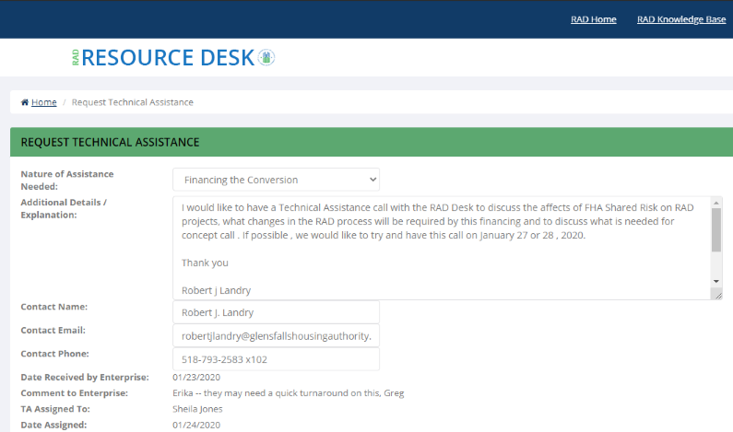
TA Request Examples
Financing the Conversion: I would like to have a Technical Assistance call with the RAD Desk to discuss the affects of FHA Shared Risk on RAD projects, what changes in the RAD process will be required by this financing and to discuss what is needed for concept call.

Slide 6
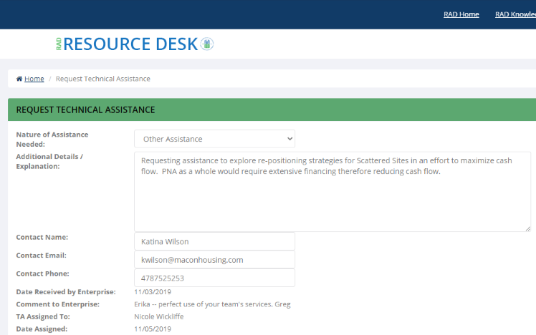
TA Request Examples
Other Assistance: Requesting assistance to explore re-positioning strategies for Scattered Sites in an effort to maximize cash flow. PNA as a whole would require extensive financing therefore reducing cash flow.

Slide 7
Process
All TA requests are submitted through RAD Resource Desk
Recap will review/approve and assign the work to its TA Contractor, Enterprise Community Partners
PHA should only have one open TA request at any time; however, PHA may make multiple requests
Each TA request generally limited to up to 16 hours

Slide 8
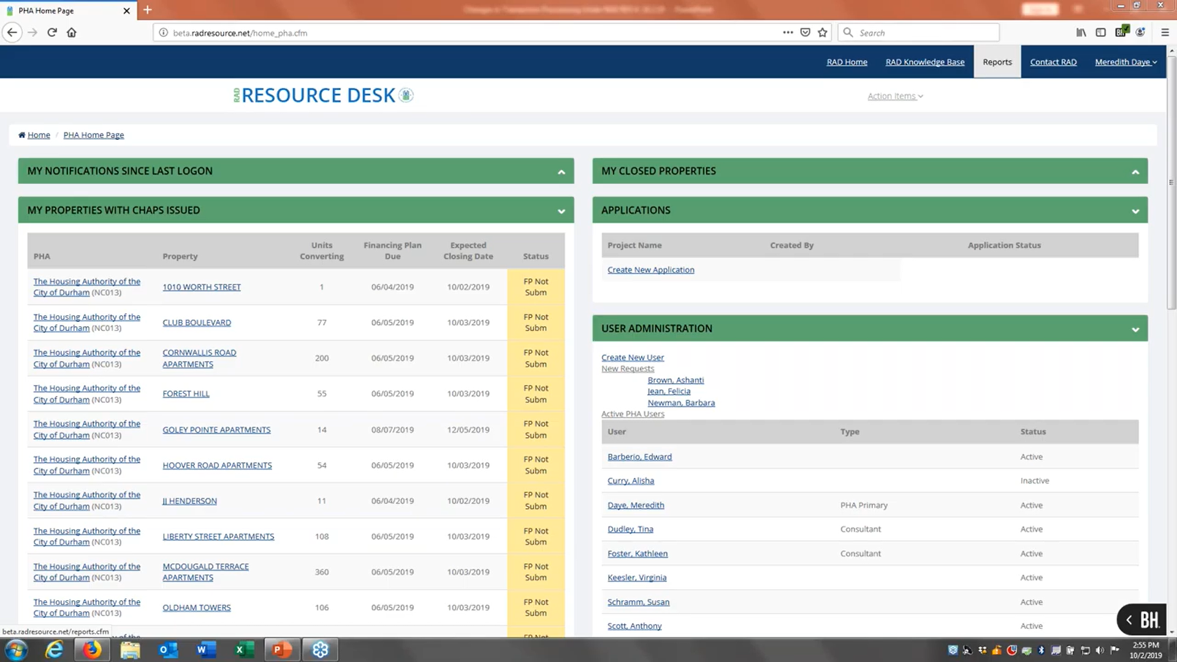
1) Go to Action Items
(show the steps in the request process)

Slide 9
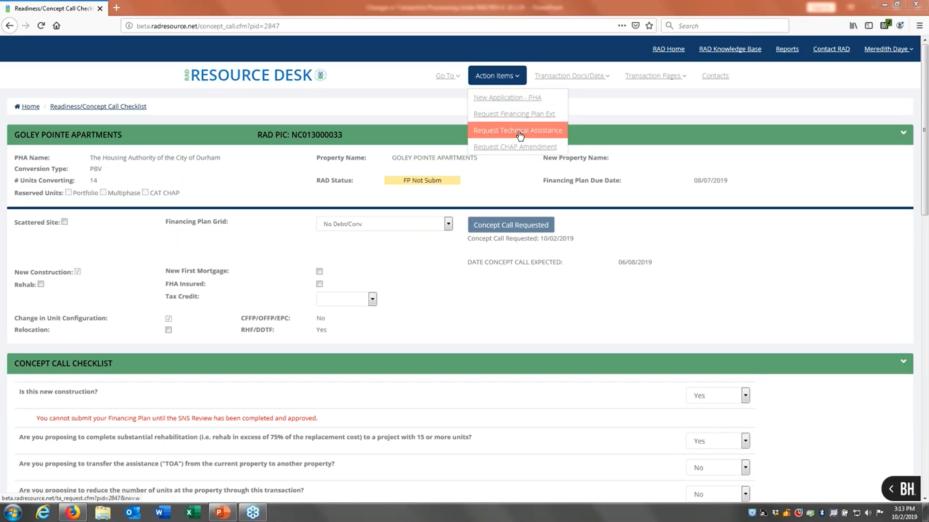
2) Click Request Technical Assistance

Slide 10
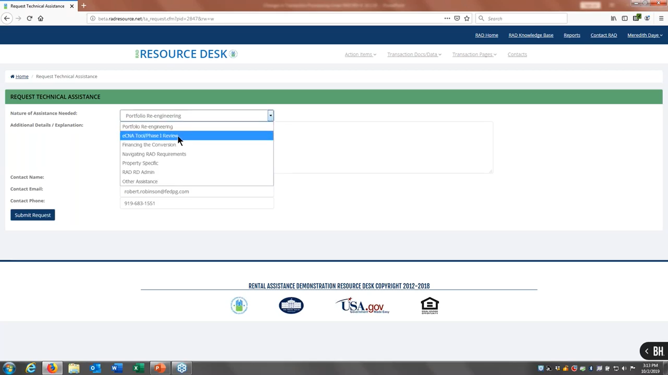
3) Choose Nature of Assistance

Slide 11
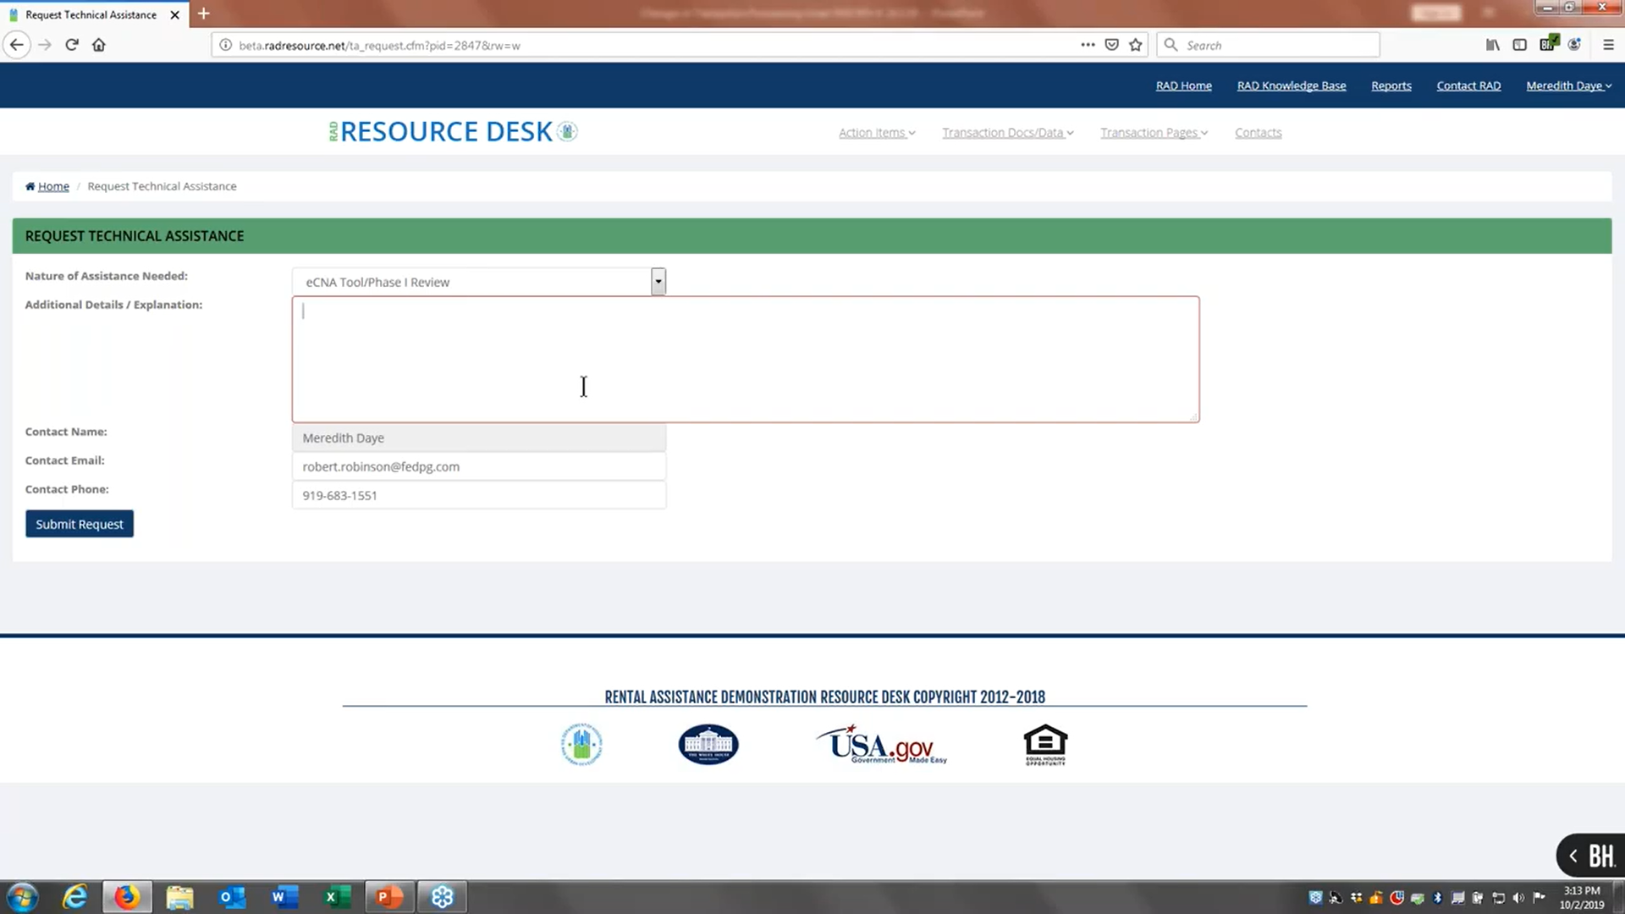
4) Add Details/Explanation

Slide 12
5) Submit

Slide 13
End of Presentation
Thank you!

