Slide 1
RAD Resource Desk
Basics & Tips for PHA Users
RAD 2020 Awardee Virtual Training
Day One
June 16, 2020
Presenter: Robert Robinson

Slide 2
Topics for Today
Registration
Navigation
Managing Users & Access
Requesting Assistance
Obtaining Necessary Approvals
Closing Your Transaction
Finalizing Your RAD Conversion

Slide 3
Resource Desk Basics
Primary Point of Contact for the RAD Program
All RAD Participants Share Data and Work
Guidance and Document Repository
Link Between HUD and Outside Parties
Administrative Record for all Transactions

Slide 4
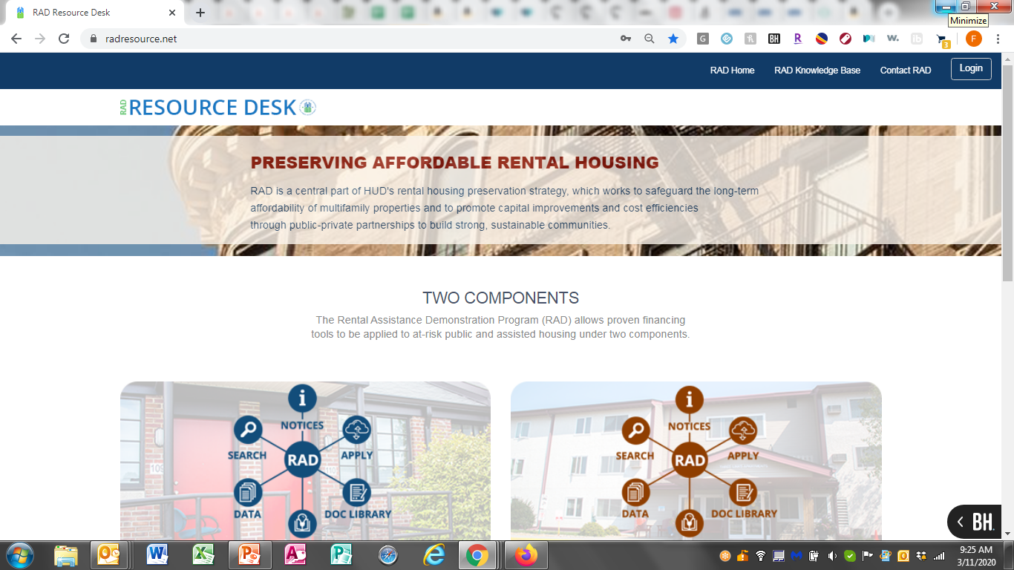
RAD Resource Desk

Slide 5
Live Demonstration
www.radresource.net

Slide 6
Topics for Today
Registration
Navigation
Managing Users & Access
Requesting Assistance
Obtaining Necessary Approvals
Closing Your Transaction
Finalizing Your RAD Conversion

Slide 7
Questions
Robert Robinson
robert.robinson@fedpg.com
202-789-5938

Slide 8
Break
Please take a quick 10-minute break and join us back at 2:00 PM for the next session:
Project Based Voucher (PBV) vs. Project-Based Rental Assistance (PBRA)

