Slide 1
PBV Versus PBRA
RAD 2020 Awardee Virtual Training
Day One
June 16, 2020
Presenter: Jaime Bordenave

Slide 2
Program Basics
RAD-PBV
Administered by PHAs
Administering Agency receives Admin Fee
PBVs are integrated into the PHA’s HCV Program
Rent Capped at lowest of a) current funding; b) 110% of FMR; c) Rent Reasonableness
Similar to HCV Program
RAD-PBRA
Administered directly by HUD’s Office of Housing
No Admin Fee for PHA
Project Owner typically manages waiting list
Rent Capped at lower of a) current funding; or b) 120% of FMR
Exceptions up to 150%, with Rent Comp Study

Slide 3
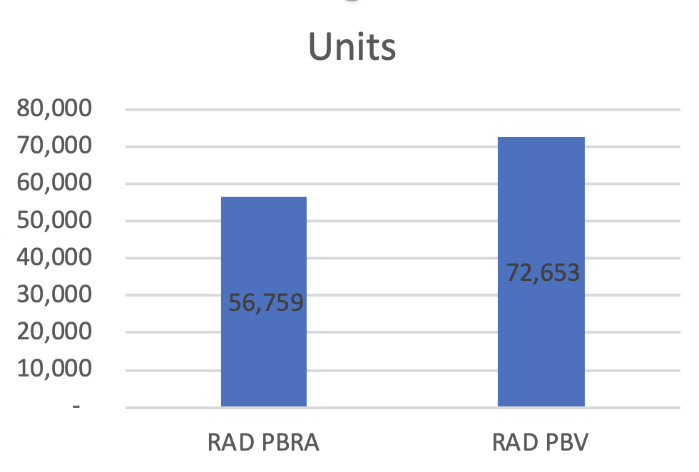
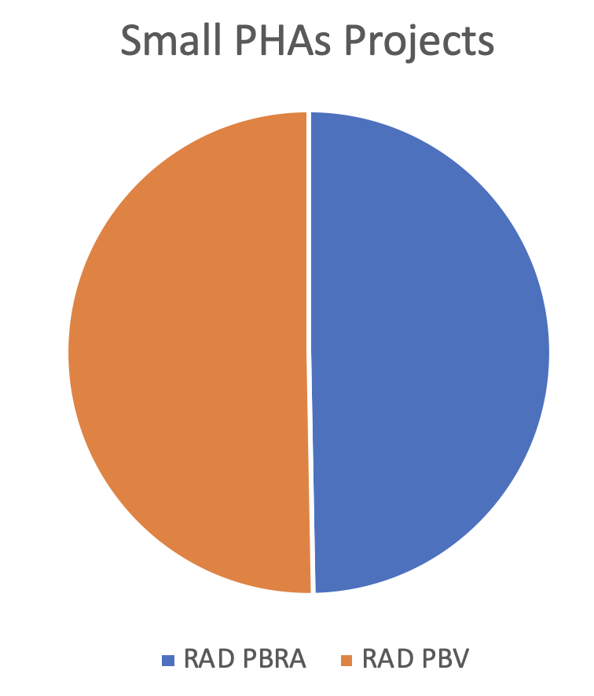
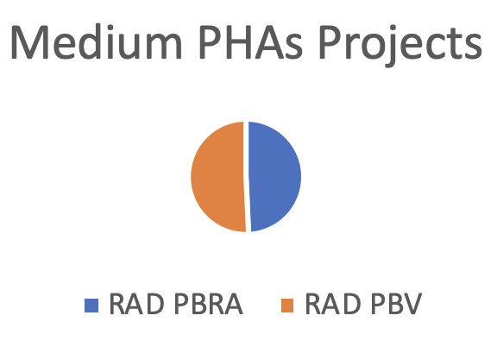
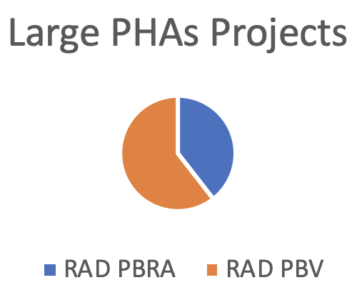
Who is Winning?
RAD Conversions to date
(Jan, 2020)

Slide 4
Why Choose PBV?
Major Reasons for Selecting PBV:
Admin Fees
More Control
Don’t like HUD’s Multi-Family Program
Grows the HCV Program—greater efficiencies
Possibly added staff retention

Slide 5
Why Choose PBRA?
Major Reasons for Selecting PBRA:
Higher Rent Cap (120%+ versus 110%)
If PHA doesn’t have a Voucher Program
Already Familiar with the PBRA Program
May work better with site-based management
Program’s long track record (1974) & strength of industry familiarity and support
Needed for $100 PUM Rent Boost—Opportunity Zones

Slide 6
What is Impacted by this Selection?
Everything!
Rent Setting/Funding
Staffing
Software Systems
Regulations
Financing Plan Requirements
Closing Documents
Leases
Capping of OCAFs
Everything!
Inspections
HAP Contract Administration
Environmental Report Requirements
Choice Mobility Options
Direct PHA Ownership
Accounting & Reporting
Lender/Investor Interest

Slide 7
Rent Setting & Funding
RAD PBRA rents can be higher than PBV, but not vice-versa
Opportunity Zone boost requires PBRA program

Slide 8
Financing Plan Requirements
PBRA Impacts
2530s required, in APPS system
Part 50 Environmental Report, with Phase 1 ESA; Part 58 for PBV
Affirmative Fair Housing Marketing Plan
Good Cause Exemption for Choice Mobility
Timing on Choice Mobility (2 years v. 1)
Limitations on Choice Mobility
Rent Comp Study needed if current funding >120% of FMRs
Different regulation on Site & Neighborhood Standards

Slide 9
HAP Contract Administration
PBV
If PHA has ownership, need an Independent Agency for HQS, Rent Reasonableness Determination, OCAF adjustments
PHA cannot contract with itself on HAP—need separate ownership entity
No Admin Fee in Year 1
PBRA
PHA could have direct ownership;
HUD directly or PBCA administers
RAD PBRA HAP is under “Old Regulation”, no restriction on cash flow

Slide 10
Excerpt from Accounting Brief #22
“. . . If the PHA that will administer the HAP contract is the same PHA that currently owns the project, HUD will normally require the project to be disposed of to another separate legal entity.”
“Normally, the PHA will establish a wholly-owned affiliate organization to own the project. The affiliate will be a separate legal entity, such as a nonprofit subsidiary, that is controlled by the PHA… The PHA will then enter into a HAP contract with the wholly-owned affiliate.”

Slide 11
Accounting & Reporting
PBV
No MORS, REAC Financial Assessment, or REAC Assessments, unless FHA-financed
Certifications and Recerts on HUD Form 50058
50058s are reported in PIC Module of HUD’s Inventory Management System
PBRA
MORS, REAC Financial Assessment and REAC Assessments are required
Certifications and Recerts on HUD Form 50059
TRACS compliant software is required

Slide 12
Impacted Elements
Rent Setting/Funding
Staffing
Software Systems
Regulations/Manuals
Financing Plan Requirements
Closing Documents
Leases
Capping of OCAFs
Inspections
HAP Contract Administration
Environmental Report Requirements
Choice Mobility Options
Direct PHA Ownership
Accounting & Reporting
Lender/Investor Interest

Slide 13
Key Guides
RAD Quick Reference Guide of Projects Converting to PBV, Oct, 2014
https://www.hud.gov/sites/documents/RAD_PBV_CONVERSION.PDF
RAD Quick Reference Guide to Multifamily Housing Requirements (PBRA), Feb, 2014
https://www.hud.gov/sites/documents/RAD_PBRAQUICKREF.PDF
RAD Guide to Choosing Between PBV and PBRA for Public Housing Conversions
See RAD Resource Desk Library (must be logged in) www.radresource.net

Slide 14
Key Guides
RAD Financing Plan Guides (RAD Resource Desk)
RAD Notice (Rev. 4)
MTW Guide for RAD (RAD Resource Desk)
HOTMA of 2016, PIH Notice 2017-21 HOTMA Implementation
Accounting Brief #22: FDS Reporting Requirements when converting under RAD
https://www.hud.gov/program_offices/public_indian_housing/reac/products/fass/pha_briefs

Slide 15
Topics Covered
I. General Provisions
Congressional Appropriations
Income Mixing
II. Contracts and Rents
Initial Contract Term
Contract Renewal
Rent Caps
Contract Rent Increases
Vacancy Payments
Rehab Assistance Payments

Slide 16
Topics Covered
III. Tenants
Re-Screening at time of Conversion
Right to Return for Initial Tenants
Phasing of Rent Increases
Resident Participation
Choice Mobility
IV. Other
Program Cap
REAC UPCS Inspections
Management & Occupancy Reviews
REAC Annual Financial Statements (AFS)

Slide 17
PBV vs. PBRA | Moderated Panel Discussion
A discussion among PHAs about their experience with each voucher platform in the RAD context.
Panelists:
Anthony Snell, Metropolitan Housing Alliance
Christina Husbands, Fresno Housing Authority
Joseph Bamberg, Boston Housing Authority
Moderator: Jaime Bordenave

Slide 18
Next Session
Requesting Technical Assistance (TA)
Greg Byrne, HUD Office of Recapitalization
Topics covered include the HUD resources available to support PHAs throughout the RAD process.

