Slide 1
RAD and Section 18 Blends
RAD 2020 Awardee Virtual Training
Day Four| June 23, 2020
Presenter: Will Lavy

Slide 2
Agenda
What is Section 18?
Developing a portfolio strategy
Combining RAD and Section 18 at a Project
RAD/Section 18 75/25 blend
RAD/Section 18 Close-out Blend
Processing
Questions

Slide 3
What is Section 18?
Section 18 of the Housing Act of 1937 authorizes the demolition or disposition of public housing.
Requirements outlined in PIH 2018-04. HUD will generally approve a property under Section 18 if it is:
Physically obsolete
Scattered site (non-contiguous) with operational challenges
Owned by a PHA with 50 units or less
RAD/Section 18 blend

Slide 4
Section 18 and Project-Based Vouchers
Section 18 Disposition can be used with the Project-Based Voucher program as a preservation and redevelopment tool
Following Section 18 approval HUD issues new vouchers (Tenant Protection Vouchers) to PHAs for units occupied with last 24 months
Vouchers can be project-based (i.e., PBV) at the former public housing site
Contract rents set at “reasonable rent” (i.e, market rent) not to exceed 110% of FMR
Tenant consent not required
PBV at former public housing property is exempt from PBV “income-mixing” requirement and not count against PHA’s PBV program cap (20%)
Competitive selection generally not required

Slide 5
Portfolio Strategy
HUD encourages PHAs to use a combination of RAD and Section 18 to preserve and improve their portfolio by transitioning properties to project-based Section 8 assistance

Slide 6
Portfolio Repositioning Strategy
Planning
Set goals for each asset: preserve, redevelop, voucher out
Categorize portfolio: e.g., obsolete, scattered site, low/moderate/high needs,”
Sequencing: dispose of assets to generate proceeds; generate fees from financing; last 50 units eligible for Sec 18
See “Asset Repositioning for PHAs” webinars on RAD Resource Desk

Slide 7
RAD & Section 18 Blends
HUD has also developed tools for PHAs to use RAD and Section 18 at the same project so as to increase revenue to support greater financing:
RAD & Section 18 75%/25% blend
RAD & Section 18 “Close-out” blend

Slide 8
RAD & Section 18 75%/25% Blend
PIH 2018-04 established that:
RAD conversions that involve new construction or substantial rehabilitation, without using 9% LIHTC, can get 25% of units approved under Section 18. Vouchers that are issued must be project-based (i.e., PBV)
Property does not need to meet any other Section 18 eligibility criteria (e.g., does not need to meet obsolescence test)

Slide 9
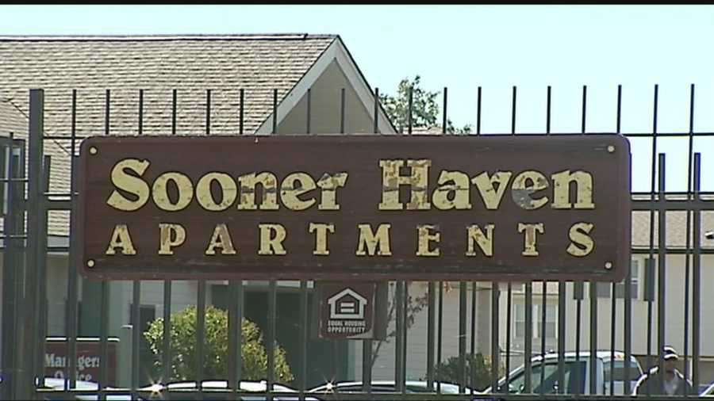
RAD & Section 18 75%/25% Blend
Sooner Haven (Oklahoma City)
150 unit garden-style property
113 units converted through RAD to PBV contract;
37 units removed through Section 18 and placed under non-RAD PBV contract
Higher revenue created ability to leverage additional $2 million in debt
Substantial rehab: $94k/unit

Slide 10
RAD & Section 18 75%/25% Blend
RAD “de minimis” reduction rule applies to whole project
All residents receive the same robust RAD rights and protections
PHA can contribute public housing funds into the development budget
“Substantial Rehab” = RAD scope of work where the hard construction costs, including general requirements, overhead and profit, and payment and performance bonds, exceed 60% of the HUD-published “Housing Construction Costs” for a given market area.
See “Workbook to Test HCC Threshold” on RAD Resource Desk

Slide 11
RAD & Section 18 Close-Out Blend
PIH 2018-04 allows a PHA to dispose of its remaining public housing ACC units through Section 18 if the PHA has 50 or fewer units
If a PHA has more than 50 units, it may:
Remove other units public housing units from its inventory through Section 18 or RAD until it has 50 or fewer units or
RAD/Section 18 Close-out Blend - if the units are in the same project, the PHA can simultaneously convert enough public housing units under RAD that would result in the PHA having 50 or fewer units and utilize the 50 or fewer option in conjunction with the RAD conversion, rather than as separate transactions.

Slide 12
RAD & Section 18 Close-Out Blend
Example:
A PHA with an 80 unit high-rise converts 30 units through RAD and takes 50 units through Section 18, all processed as one HUD transaction

Slide 13
RAD & Section 18 Close-Out Blend
All residents receive the same robust RAD rights and protections
PHA can contribute public housing funds into the development budget
PHA must agree to “close-out” its public housing program

Slide 14
Processing RAD & Section 18 Blends
Apply for RAD for the entire project (through the RAD Resource Desk)
Front-end civil rights reviews should reflect the entire project
Request the use of a RAD & Section 18 blend in the RAD Financing Plan
Financing Plan must reflect the entire project (e.g., CNA, operating pro form
No separate Section 18 application needed. Instead certain additional items needed in the Financing Plan

Slide 15
Processing RAD & Section 18 Blends
HUD will revise the CHAP and create the Section 18 application (using materials provided in the Financing Plan)
Upon approval of the Financing Plan, HUD will issue the RCC and the Section 18 approval letter
PHA applies for tenant protection vouchers
Closing will involve:
Disposition of property
Closing of any financing
Release of DOT from entire project
Recordation of RAD Use Agreement (with rider) on entire project
Execution of RAD HAP contract and non-RAD PBV HAP (or AHAP, if applicable)

Slide 16
Loose Ends
PHA is potentially eligible for Demolition Disposition Transition Funding (DDTF) and Asset Repositioning Fee (ARF) for Section 18 units
Only if PHA has eligible uses
Not eligible for ARF if Section 18 units are in the same building as RAD units

Slide 17
More Information
See “RAD and Section 18 Blend FAQs” on the RAD Resource Desk

Slide 18
Quiz #1
Which blend option requires the PHA to agree to terminate its public housing program?
75%/25% Blend
Close-out Blend
Both

Slide 19
Quiz #2
Can the units that convert through RAD be placed under the same HAP contract as the units removed through Section 18?
Yes
No

Slide 20
Questions?

