Slide 1
Closing Your Transaction: Guide to a Successful RAD Closing for Public Housing Conversions
RAD 2020 Awardee Virtual Training​​​
Day Five| June 24, 2020​​​
Presenter: Bev Rudman, Director of Closing & Post-Closing, Office of Recapitalization

Slide 2
Topics for Today
Start early - before RCC
Know the parties
Know the process
Know your post-closing responsibilities

Slide 3
Start Early-Ownership Entity
Ownership and control requirements in RAD Notice
Check that information you entered on RAD Resource Desk is correct
For all FHA-RAD and for all PBRA--Submit required APPS/2530 submissions and AFHMP to your local MF Field Office

Slide 4
Start Early-Operations & Mgmt
Identify experienced management agent
Get staff and systems ready
Understand Section 8 reporting requirements
Determine number of HAP contracts
PBV: If needed, identify a third party to perform inspections and rent adjustments
Review waitlist policies and admission rences

Slide 5
Start Early-Assemble Closing Team
Main internal contact for RAD closing
Determine if using external consultants
Obtain counsel with RAD experience
Review title--avoid surprises!
Review the PBV or PBRA Closing Checklists and contracts/forms found on www.radresource.net.

Slide 6
Start Early-Financing
Lenders and investors should understand RAD requirements, especially subordination to Use Agreement
Funding in closing year– review the Initial Year Funding Tool
Existing Mixed Finance conversions
Know your deadlines

Slide 7
Start Early-Residents
Establish and maintain communication with existing residents
Understand required communications
Understand right to return
Communicate!!

Slide 8
Start Early—The Money
Review your RAD CHAP Award CAREFULLY
Check the unit mix and rents
Check the utility allowances
Check for potential rent flexibilities in the
RAD CHAP Amendment & Rent Flexibility guide
One chance to convert funds for the project at closing through Sources and Uses

Slide 9
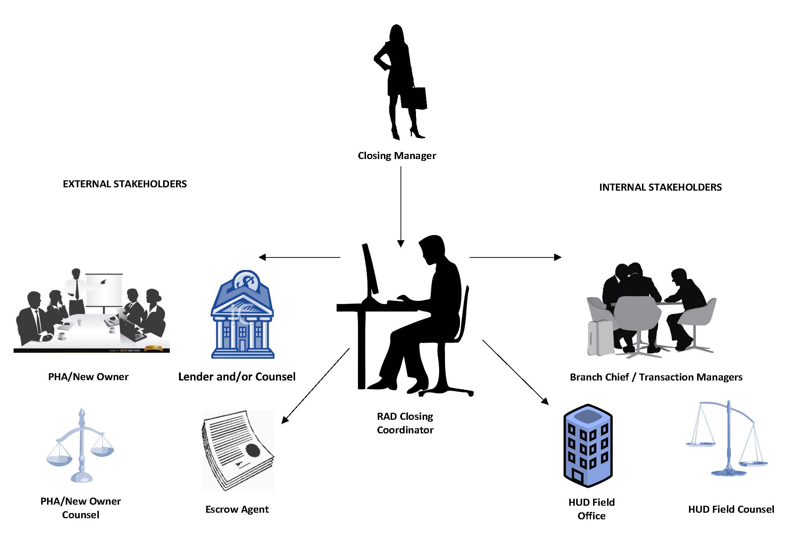
Key Players

Slide 10
RAD Closing Coordinator
Main point of contact after RCC is issued
Reviews and approves various documents
Reviews RCC amendments and extension requests
Ensures all RCC Special Conditions are cleared prior to closing
Establishes logistics for sending out notarized documents
Notifies SAC when RAD closing occurs
Coordinates with HUD HQ on initial year funding
KEEPS ALL PARTIES MOVING TOWARDS CLOSING

Slide 11
HUD Field Counsel
Reviews documents on the checklist
Advises on legal issues
Determines whether certain requirements are met
Provides legal approval to move to closing

Slide 12
More Folks At HUD
Transaction Manager, Office of Recap
PIH Field Office
Multifamily Field Office
FHEO

Slide 13
Start the Closing Process
Follow PBV or PBRA Closing Checklist
Submit DRAFT documents for HUD to review – nothing is executed at this stage
Best practice - Submit draft package within 2 weeks of RCC issuance
Package should be submitted to HUD no later than 2 months following RCC issuance

Slide 14
Get to the Finish Line
Communicate any deadlines
RAD Closing Coordinator completes final program review
HUD Counsel completes final legal review
PIH completes approval process
Leave time for notarized signatures and moving PAPER documents
Year-End Closing Requirements

Slide 15
Post-Closing
Immediately following recording, email to RAD Closing Coordinator
Recorded Release of DOT
Recorded RAD Use Agreement
Fully executed HAP Contract(s)
Final Closing Dockets
Upload on the Resource Desk-final executed and recorded documents of anything reviewed by HUD during closing

Slide 16
Completion Certifications
When New Construction or Rehab:
3rd Party Certification that RAD Scope of Work is complete
Final Sources and Uses
Resident information to ensure right to return is upheld
When no Scope of Work in the RCC:
Due within 10 days of HAP effective date
Provide certification of IDRR deposit
Resident information to ensure right to return is upheld
Section 3 submission

Slide 17
Post-Closing Changes or Problems
RAD Resource Desk transaction page for Post-Closing Processing
If RAD Scope of Work is not complete, use the RAD Resource Desk page
After RAD Scope of Work is complete AND completion certification is accepted, go to assigned Account Executive (PBRA & FHA-insured PBV) or to PIH (PBV)

Slide 18
Good Luck
You’ve got this!

Slide 19
Next Session
Post-Closing: Operationalizing the Conversion | Moderated Panel
Topics covered include life after closing, the new day-to-day normal, and next steps for your PHA.
Yvette Viviani, HUD Office of Multifamily Housing Programs
Nick Bilka, HUD Office of Voucher Programs
Moderator: Will Lavy

