Slide 1
Making Changes to Your CHAP: Crash Course on CHAP Amendments & Contract Rent Flexibilities
RAD 2020 Awardee Virtual Training​​​
Day Five| June 24, 2020​​​
Presenters: Liane Houseknecht & Dan Gordon
Contractors - Office of Recapitalization

Slide 2
What will you learn today?
Understand your CHAP Award
How to request changes to your CHAP (“CHAP amendment”)
Understand rent flexibilities & what changes are possible
You will be reminded about utility allowances
Tips & best practices
Ask Questions

Slide 3
A Closer Look at Your RAD CHAP Award
After applying for RAD, your PHA receives a RAD CHAP Award based on the information provided in your application
The CHAP includes an Exhibit A with the following key information:
PIC Development Number(s) of the converting units
Unit mix by bedroom type
Contract rents
Utility Allowances
Fiscal Year of RAD contract rents
Memorializes what OCAFs have been added to the contract rents

Slide 5
Why is this important?
CHAP = HAP
Ensuring your unit mix, rents, and utility allowances are correct and final in your CHAP means you will close with a correct HAP!
What’s in your CHAP is what goes into your RAD Conversion Commitment (RCC) and into your RAD PBV or PBRA HAP contract

Slide 6
What is a CHAP Amendment?
request a CHAP amendment!
Most exchanges accepted, no receipt required, no mailing labels needed!

Slide 7
What is a CHAP Amendment?
A change to any information in your CHAP requires a CHAP amendment
Check out “CHAP Amendment Overview & Contract Rent Flexibilities” in the RAD Resource Desk Document Library (updated 4/17/20)
Submit complete requests,
well in advance of concept call

Slide 8
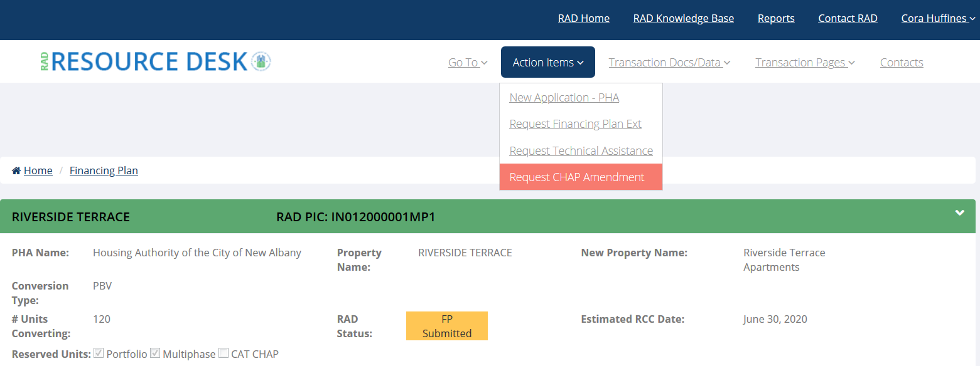
How do I request a CHAP Amendment?
Amendment requests are submitted online via www.radresource.net > select the project with an active CHAP > Action Items > Request CHAP Amendment

Slide 9
How do I request a CHAP Amendment?

Slide 10
Structuring Your CHAP
Does the project you applied for still make sense?
Combining multiple CHAPs into a single CHAP
Splitting an existing CHAP into
multiple CHAPs (“One to Many”)
“Many to One” CHAP – combining
units from one or more PIC
development numbers into a single
CHAP
Note: Contract rents will be weighted
based on the contract rents of the developments involved

Slide 11
Structuring Your CHAP
Unit reconfiguration/unit mix
Adding units from the same AMP to an existing CHAP
Depending on the scenario, this can be done via an amendment OR you may need to submit an application and then process an amendment to combine the units
Reducing RAD units
De minimis reduction
RAD/S18 blend

Slide 12
A Note About Your RAD Portfolio
Do you have lots of active CHAP awards? Are you concerned about missing deadlines? Feeling overwhelmed?
Consider a Retroactive Portfolio Award!
Must retain active CHAP awards for 25% of units covered by the portfolio award OR 4 properties
Recap will withdraw remaining CHAPs that you are not ready to proceed on and those units will be “reserved” through 2024
Portfolio award locks in the current RAD contract rent base
year
You will still need to apply to obtain future CHAPs, but
won’t be subject to the waitlist should one form

Slide 13
Contract Rent Flexibilities
Switching contract rent base years
Rent bundling
MTW augmentation
Opportunity Zone Rent Boosts
RHF/DDTF Augmentation
Special Purpose Units
Excess utility surcharge
Tenant Paid Utility Savings
Annual OCAF adjustments

Slide 14
Contract Rent Base Rent Year
Applicable for: All CHAP Awardees
The rents in your RAD CHAP award are issued based on the rents in effect at CHAP issuance
Exception: Portfolio Awards “lock in” the RAD Rent Base Year so if you submit a CHAP covered by a portfolio award, it will have rents based on the rent base year of your portfolio award
You can request to “withdraw” your CHAP and switch to the most current RAD rents in effect

Slide 15
Contract Rent Base Year
WE ARE HERE

Slide 16
Contract Rent Base Year
If your CHAP was issued here, you can request to switch rents

Slide 17
Contract Rent Base Rent Year
Not sure what rent base year your rents reflect? Check Ex A of your CHAP award – top paragraph
View the FY18 rents here:
https://www.hud.gov/RAD/library/notices

Slide 18
Rent Bundling
Applicable for: All CHAP awardees with 2 or more active CHAPs*
PHAs can rent bundle among two or more projects with active CHAPs
*PHAs can also bundle with non-RAD PBV units, like in a RAD/S18 blend

Slide 19
Rent Bundling
CHAP 1
CHAP 2
AMP 100
50 3BR units
$800 PUPM
$40,000 PM
Total Monthly Income:
$70,000
AMP 200
50 3BR units
$600 PUPM
$30,000 PM
DONOR
RECEIVER
AMP 100
50 3BR units
$700 PUPM
$35,000 PM
AMP 200
50 3BR units
$700 PUPM
$35,000 PM
Total Monthly Income:
$70,000

Slide 20
Rent Bundling
“Donor” property (lower rents) must close before or at the same time as “Receiving” property (higher rents)*
Complete Rent Bundling Worksheet and submit with your amendment request
Worksheet available on RAD Resource Desk Doc Library
*If bundling with a non-RAD PBV HAP contract, the HAP effective date of the “donor” property must be prior to or the same as the “recipient” property HAP contract effective date

Slide 21
MTW Augmentation
Applicable for: MTW agencies only
Can augment contract rents with MTW funds
Applicable rent caps still apply unless the caps have been modified through the MTW Plan
Subject to a Subsidy Layering Review at Financing Plan submission

Slide 22
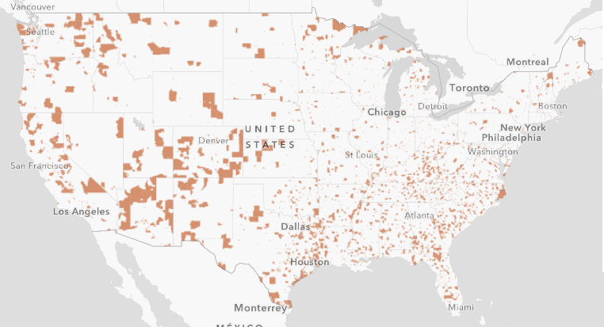
Opportunity Zone Rent Boost
Applicable for: PBRA conversions doing new construction or sub rehab in a designated Opportunity Zone
Provide evidence that project won’t be viable without the boost
Up to $100 PUPM (subject to existing rent caps)
See FAQs for more information:
https://radresource.net/output.cfm?id=ozfaqs

Slide 23
Future or Existing RHF/DDTF Augmentation
Applicable for: PHAs with existing (unobligated) RHF or DDTF grants or future DDTF grants
PHAs can forgo future DDTF grants to augment RAD contract rents
HUD will provide you with a forecast of the amounts
Can also “trade in” awarded but not yet obligated DDTF grants to augment rents

Slide 24
Special Purpose Units
Applicable for: PHAs who have units under ACC that will be used for supporting residents/resident services
Project can retain the subsidy attributable to those units and the contract rents for the dwelling units will increase by a share of the foregone subsidy (i.e., the Operating Fund and Capital Fund portion of the weighted Contract Rent)

Slide 25
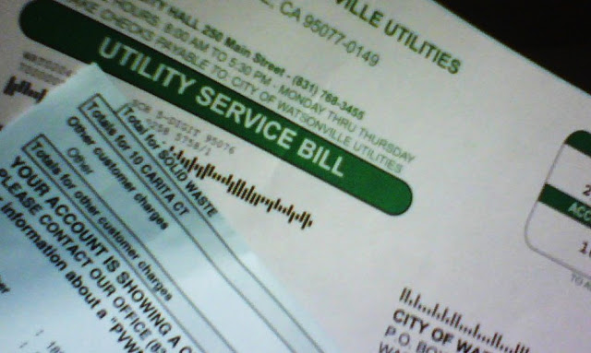
Excess Utility Surcharge
Applicable for: PHAs currently doing “check metering” and surcharges for excess resident utility usage of PHA-supplied utilities
Section 8 does not permit this practice
PHAs can augment RAD
contract rents with the
excess utility surcharge
amount

Slide 26
Tenant Paid Utility Savings
Energy efficiency = lower resident costs, higher rents!
If your project has tenant paid utilities and the RAD scope of work includes energy efficient improvements which will reduce resident utility expenses (as determined by a third party professional study), you are permitted to augment your RAD contract rents by 75% of the projected utility savings

Slide 27
Tenant Paid Utility Savings
Your amended RAD CHAP award (& HAP contract) will reflect two rent schedules – a “pre rehab” version with your current contract rents and existing utility allowances and a “post rehab” version with the augmented contract rents and reduced utility allowances
Your higher “post rehab” rents go into effect at construction completion (& submission of
RAD Completion Certification to Recap)

Slide 28
OCAF Adjustments
Applicable for: All PHAs with active CHAPs
After CHAP issuance and before closing, each CHAP award is eligible for an annual OCAF adjustment on a calendar year basis
This is automatically applied – you do not need to request a CHAP amendment
Typically, OCAFs are published in Oct/Nov and are applied to transactions starting in January of the next calendar year

Slide 29
Utility Allowances

Slide 30
Utility Allowances
THE RULE
Whenever residents will continuously live at the property following the conversion, the CHAP, RCC, and HAP contract must reflect the utility allowance currently in effect at the property prior to conversion (the current Public Housing utility allowance in place)

Slide 31
Utility Allowances
Exceptions to the Rule: PBV & PBRA
If no residents will be living at the project following conversion, the project can close with the future (post-rehab) utility allowance*, calculated in accordance with Notice H 2015-04
*For PBV, the utility allowance would be the HCV utility allowance schedule or a site-specific utility allowance

Slide 32
Utility Allowances
Changing utility responsibilities
The RAD contract rents are calculated using the existing utility configuration at the property meaning if the owner is paying some or all utilities, the contract rents factored in that ongoing expense
A change in utility responsibilities (owner v. tenant paid) impacts the contract rents
If the change is made at closing (rare) or if no residents will be living at the site, the rents and utility allowances should be adjusted in the CHAP. Otherwise, the adjustment will occur post-closing after the change has been operationalized

Slide 33
Utility Allowances
Changing utility responsibilities
Example: All utilities are currently owner paid. As part of the RAD Scope of Work, the project will switch to tenant paid utilities. Residents will be relocated during the entire rehab.
Original CHAP:
Amended CHAP:
No. Units | Bedroom Type | Contract Rent | Utility Allowance | Gross Rent
100 | 1 | $500 | $0 | $500
No. Units | Bedroom Type | Contract Rent | Utility Allowance | Gross Rent
100 | 1 | $425 | $75 | $500

Slide 34
Utility Allowances: Tips
The RAD application does not allow you to input different utility allowances for the same bedroom type. The CHAP does. AMEND IT!
This is really important to get right, especially in your HAP contract
No. Units | Bedroom Type | Contract Rent | Utility Allowance | Gross Rent
45 | 1 | $450 | $75 | $525
20 | 1 | $450 | $80 | $530
10 | 1 | $450 | $73 | $523
25 | 2 | $560 | $91 | $651
5 | 2 | $560 | $97 | $657

Slide 35
Amendment Tips & Best Practices
Review your CHAP unit mix, utility allowance information early and often
Don’t wait – review your CHAP and all potential changes early & well in advance of your concept call
Submit a complete amendment request – include all required supporting documentation
Don’t forget about rent caps!
Consult the Guide!
Ask for help! Email resourcedesk@radresource.net

Slide 36
Thank you for joining us! Questions?
Liane Houseknecht – liane.Houseknecht@fedpg.com
Dan Gordon – Daniel.Gordon@fedpg.com
Email resourcedesk@radresource.net
A+

Slide 37
Next Session
10 Minute Break
Please meet back here at 2:05 PM EST

